Slide 1
Hemoglobin A1c Targets for Glycemic Controls
National Center for Health in Public Housing Clinical Quality Working Group

Slide 2
Diabetes in PHPC Settings

Slide 3
HBA1c>9 in PHPC Settings
Notes:
PHPC: obese/overweight: 15%
PHPC: Hypertension: 29.9%

Slide 4
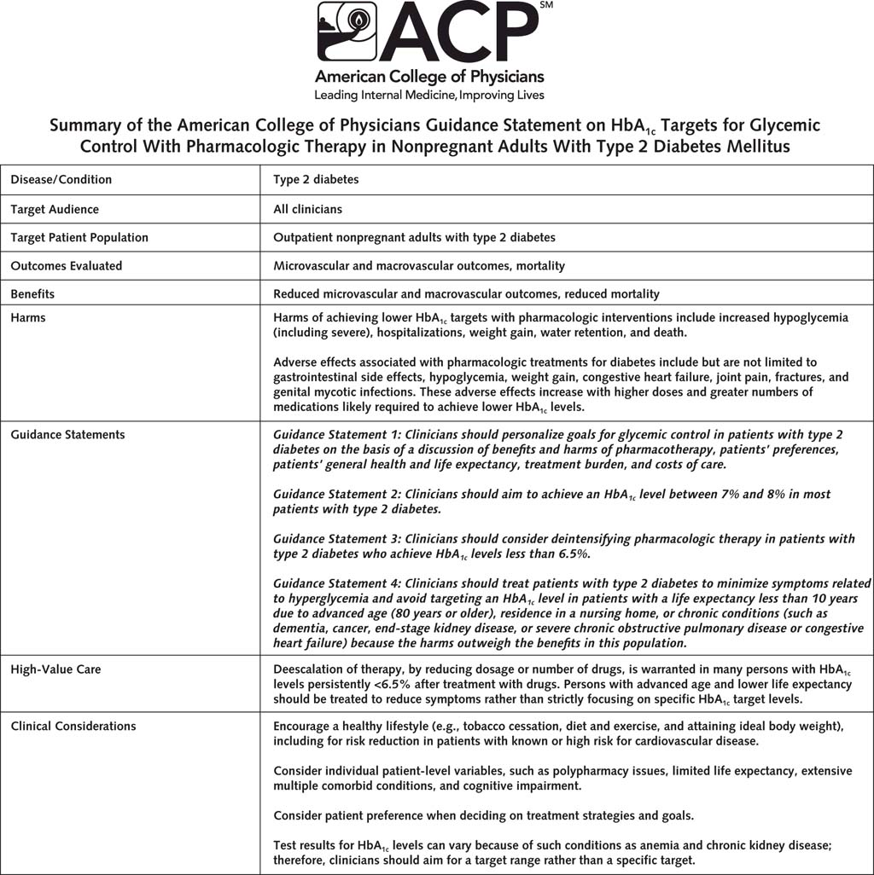

Slide 5
American Diabetes Association’s Press Release
The ADA has long recommended that treatment goals be individualized based on factors both modifiable and nonmodifiable, such as age, life expectancy, duration of disease, resources and support, and comorbid conditions. The ADA recommends that a reasonable A1C goal for many nonpregnant adults with type 2 diabetes is less than 7 percent based on the available evidence to date from the ACCORD, ADVANCE, VADT and UKPDS international clinical trials, which were evaluated and incorporated into ADA’s Standards of Care.

Slide 6
What Glycemic targets/protocols/algorithms do you use?

Slide 7
Glycemic Targets
Two primary techniques:
Patient self-monitoring of blood glucose (SMBG)
A1C
Continuous glucose monitoring (CGM)

Slide 8
A1c Testing Recommendations
Perform the A1C test at least two times a year in patients who are meeting treatment goals
Perform the A1C test quarterly in patients whose therapy has changed or who nor meeting glycemic goals
Point-of-care testing for A1C provides the opportunity for more timely changes

Slide 9
What care management approaches are being used to achieve glycemic targets?

Slide 10
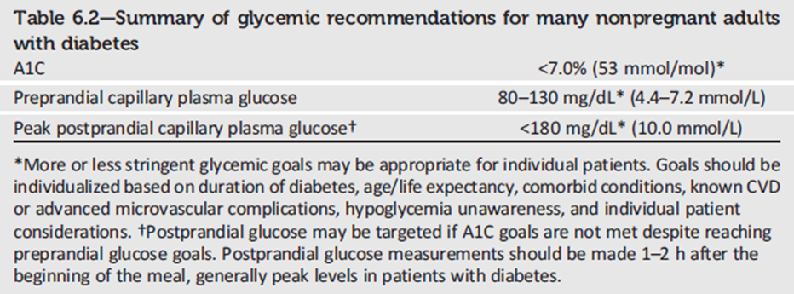
Summary of Glycemic Recommendations

Slide 11
Barriers to Successful Management of Diabetes
Clinical limitations
Clinical inertia
Underutilization of team support
Treatment nonadherence:
*psychosocial
*environmental
*interpersonal
*socioeconomic
*treatment-related

Slide 12
What barriers are affecting patients to achieve glycemic targets?

Slide 13
How do social and environmental factors contribute to comorbidities? How can treatment plans address SDOH?

Slide 14
What resources have been helpful in improving self-management for patients who have diabetes?
How can electronic health record systems be leveraged to further improve diabetes-related outcomes for diabetic patients with uncontrolled diabetes?

