Slide 1
Diabetes: Microvascular Complications and Foot Care
National Center for Health in Public Housing Clinical Quality Working Group

Slide 2
Diabetes in PHPC Settings

Slide 3
HBA1c>9 in PHPC Settings
Notes:
PHPC: obese/overweight: 15%
PHPC: Hypertension: 29.9%

Slide 4
Barriers to Successful Management of Diabetes
Clinical limitations
Clinical inertia
Underutilization of team support
Treatment nonadherence:
*psychosocial
*environmental
*interpersonal
*socioeconomic
*treatment-related

Slide 5
Diabetes Self-Management Education and Support

Slide 6
Diabetes Programs and Initiatives

Slide 7
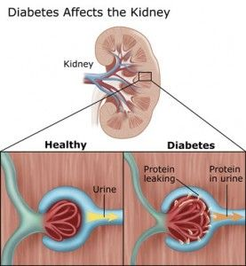
Diabetic Kidney Disease
Screening
At least once a year assess urinary albumin and eCGR in patients with type 1 diabetes with duration of >5years, in all patients with type 2 diabetes, and in all patients with comorbid hypertension

Slide 8
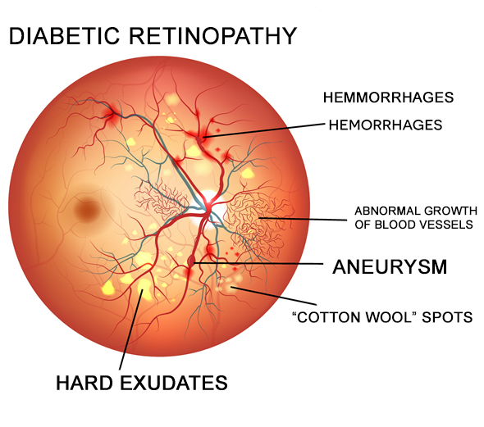
Diabetic Retinopathy
Screening
Adults with type 1 diabetes should have an initial dilated and comprehensive eye examination within 5 years after the onset of diabetes
Patients with type 2 diabetes should hae an initial dilated and comprehensive eye examination at the time of diagnosis
Subsequent dilated retinal examinations should be repeated at least annually

Slide 9
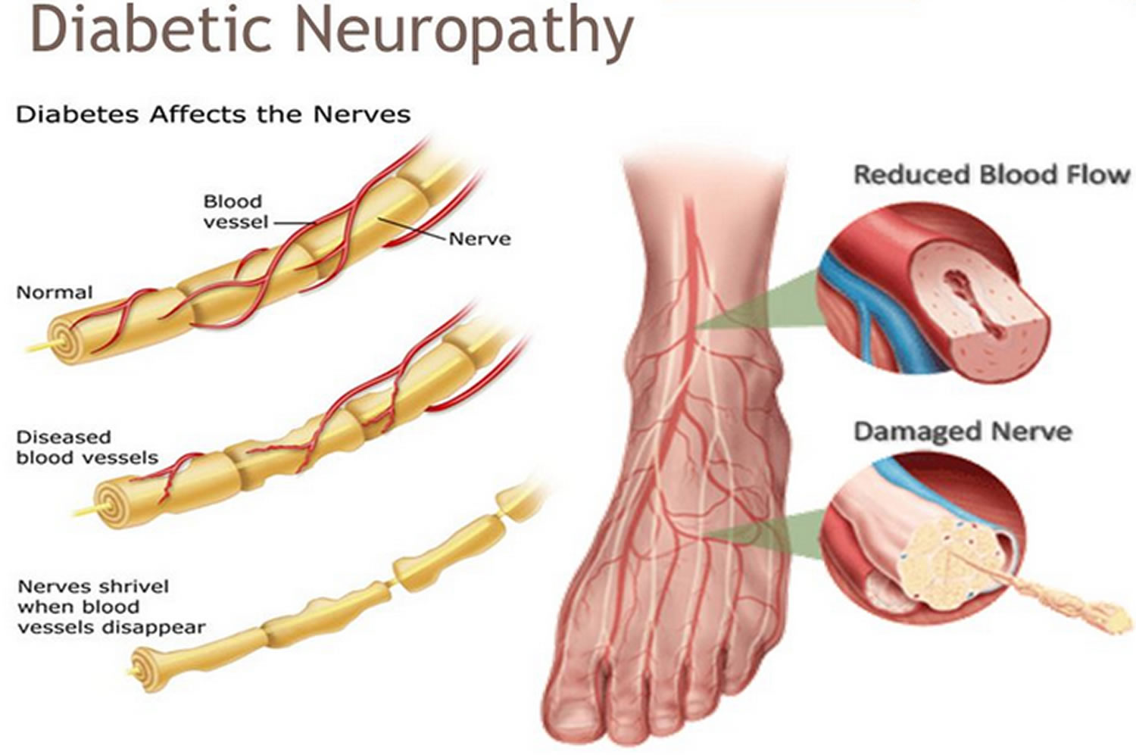
Diabetic Neuropathy
Screening
All patients should be assessed for diabetic peripheral neuropathy starting at diagnosis of type 2 diabetes and 5 years after diagnosis of type 1 diabetes and at least annually thereafter

Slide 10
Diabetes & Foot Care
Recommendations
Perform a comprehensive foot evaluation at least annually to identify riks factors for ulcers and amputations
All patients with diabetes should have their feet inspected at every visit
Patients with symptoms of claudication or decreased or absent pedal pulses should be referred for ankle-brachial index and for further vascular assessment as appropriate

