Slide 1
PREDIABETES
Strategies for Effective Screening, Intervention and Follow-up

Slide 2
Learning Objectives
Define prediabetes
List risk factors and clinical signs in individuals at risk for type 2 diabetes
Identify interventions to modify risk factors to preventing type 2 diabetes
Develop a strategic management plan to proactively screen, assess, follow-up, and evaluate patients with prediabetes
Discuss the benefits of a team-based approach to assist individuals with prediabetes to achieve their target goals and objectives

Slide 3
What is Prediabetes?
Fasting Plasma Glucose
2-hour Plasma Glucose On OGTT
Hemoglobin A1C
Diabetes Mellitus
Diabetes Mellitus
Diabetes Mellitus
126 mg/dL
200 mg/dL
6.5%
Prediabetes
Impaired Fasting
Glucose
Prediabetes
Impaired Glucose
Tolerance
Prediabetes
100 mg/dL
140 mg/dL
5.7%
Normal
Normal
Normal
Any abnormality must be repeated and confirmed on a separate day
The diagnosis of diabetes can also be made based on unequivocal symptoms and a random glucose >200 mg/dL
Adapted from: American Diabetes Association. Diabetes Care. 2014;37 Suppl 1:S81-90.

Slide 4
Prediabetes
An important risk factor for future diabetes and CV disease
Risk for prediabetes is a continuum
Important to identify early and begin intervention immediately
Interventions can reduce the rate of progression from prediabetes
to diabetes
Healthy diet
Physical activity
Weight loss
American Diabetes Association. Diabetes Care. 2014:37 Suppl 1:S81-90.

Slide 5
Prediabetes
Long-term consequences include
Hypertension¹
Cancer²
Risk increased by 15%
Stomach/colorectal, liver, pancreas, breast, endometrium
Alzheimer’s disease³
American Diabetes Association. Diabetes Care. 2014:37 Suppl 1:S81-90.
Baker LD, et al. Arch Neurol. 2011;68:51-57.
Huang Y, et al. Diabetologia. 2014 Sep 11. [Epub ahead of print]

Slide 6
Impaired Fasting Glucose and Impaired Glucose Tolerance
Not clinical entities but rather risk factors for diabetes and cardiovascular disease
Associated with:
Physical inactivity
Obesity (especially abdominal, or visceral)
Dyslipidemia
– High triglycerides and/or low HDL cholesterol
Hypertension
American Diabetes Association. Diabetes Care. 2014:37 Suppl 1:S81-90.

Slide 7
Prediabetes
Centers for Disease Control, 2017
33.9% (84 million) U.S. adults aged 20 years or older have prediabetes¹
o Percentage was similar by race
o 51% aged ≥65 years
Only 11.6% were aware they had it²
In adolescents aged 12 to 19 years, prevalence of prediabetes and diabetes increased from 9% to 23%³
National Diabetes Statistics Report. Available at: cdc.gov/diabetes/pubs/statsreport14.htm.
CDC. MMWR Morb Mortal Wkly Rep. 2013;62:209-212. 3. May AL, et al. Pediatrics. 2012;129:1035–1041.

Slide 8
Projecting the Future Diabetes Population: It Is Growing
Adapted from:
Boyle JP, et al. Popul Health Metr. 2010;8:1-12.

Slide 9
Determinants of Prediabetes/Type 2 Diabetes: A Call to Action
There is an association between social and environmental factors and development of obesity and type 2 diabetes
Better understanding needed
Variables that influence behaviors that lead to obesity, prediabetes, and diabetes
How to modify these variables
Perform research conducted on community- level interventions
Identify individuals at risk
Adapted from:
Hill J. O. et al. Diabetes Care. 2013;36:2430-2439.

Slide 10
Prediabetes
Process for Diagnosing
S | Screen
A | Assess and Advise
F | Follow-up
E | Evaluate progress

Slide 11
S | Screen
A | Assess and Advise
F | Follow-up
E | Evaluate progress

Slide 12
Screening for Diabetes
Be proactive in an effort to improve outcomes
Find who might have risk factors
Ask patients to take the ADA Diabetes Risk Test*
Depending on results, invite them into the office to be tested
If diagnosed with diabetes/
prediabetes
Assess and advise
Follow-up
Evaluate
* Available at: www.diabetes.org/risktest

Slide 13
Criteria for Screening for Prediabetes/Type 2 Diabetes in Asymptomatic Adult Individuals
DIABETES RISK FACTORS
Physical inactivity
First-degree relative with diabetes
High-risk race/ethnicity
Women who delivered a baby weighing >9 lb or were diagnosed with GDM
Hypertension (≥140/90 mmHg or
on therapy for hypertension)
HDL-C <35 mg/dL and/or a TG >250 mg/dL
A1C ≥5.7%, IGT, or IFG on previous testing
Other clinical conditions associated with insulin resistance, such as severe obesity, acanthosis nigricans, PCOS
History of CVD
Consider testing (screening) all adults with a BMI* ≥25 kg/m² and additional risk factors
o If no risk factors, consider screening no later than age 45 years
If normal results, repeat testing (screening) at ≥3-year intervals
More frequently depending on initial test results and risk factors
Test yearly if prediabetes
*At-risk BMI may be lower in some ethnic groups
Adapted from:
American Diabetes Association. Testing for Diabetes in Asymptomatic Patients.
Diabetes Care. 2014;37(suppl 1):S17; Table 4

Slide 14
Modifiable Risk Factors of Diabetes/Prediabetes for CV Disease
Non-modifiable |  | Modifiable
Age |  | Physical inactivity
Race/Ethnicity |  | Overweight/Obesity
Gender |  | Hypertension
Family history |  | Smoking
 |  | Abnormal lipid metabolism
 |  | High plasma glucose levels
American Diabetes Association. Diabetes Care. 2014:37:S14-80.

Slide 15
S | Screen
A | Assess and Advise
F | Follow-up
E | Evaluate progress
CHILDREN/ADOLESCENTS

Slide 16
Prevalence of Prediabetes in Children/Adolescents in the U.S.
Li C, et al. Diabetes Care. 2009;32:342-347.

Slide 17
Screening Children for Prediabetes and Diabetes
Consider for all children who are overweight and have 2 of any of the following risk factors
Family history of type 2 diabetes in first- or second-degree relative
High-risk race/ethnicity
Signs of insulin resistance or conditions associated with insulin resistance
Maternal history of diabetes of GDM during child’s gestation
Begin screening at age 10 years or onset of puberty
Screen every 3 years
A1C test is recommended for diagnosis in children
Adapted from: ADA. Testing for Diabetes in Asymptomatic Patients. Diabetes Care. 2014;37(suppl 1):S17-18.

Slide 18
S | Screen
A | Assess and Advise
F | Follow-up
E | Evaluate progress
GESTATIONAL DIABETES (GDM)

Slide 19
GDM
Progression to Prediabetes
With GDM, the risks for abnormal glycemia can persist even after the early postpartum period
Risk factors included:
 3-month postpartum glucose
 Leptin
 HDL-C
 LDL-C
 Triglycerides
 Adiponectin
Adapted from: Retnakaran R, et al. Obesity (Silver Spring). 2010;18:1323-1329.

Slide 20
Risk of Prediabetes in Adolescent Offspring of Mothers with GDM
Obese adolescents with
normal glucose tolerant (NGT) (N=255)
No Exposure to GDM (n=210; 82.3%)
Exposure to GDM (n=45; 17.7%)
Approx 5.75 times increase in risk; p < .001
Adapted from: Holder T, et al. Diabetologia. 2014; DOI 10.1007/s00125-014-3345-2.

Slide 21
GDM
Screening and Diagnosis
For women not previously diagnosed with overt diabetes: Use 1 of 2 methods
ONE-STEP (IADPSG)
Screening (at 24-28 weeks gestation)
75-g OGTT in the AM after an overnight fast of at least 8 hours; measure PG during fasting, at 1 hour, and at 2 hours
TWO-STEP (NIH Consensus) Screening (at 24-28 weeks gestation)
50-gram non-fasting OGTT with PG measurement at 1 hour (Step 1)
If PG level at 1 hour after load is
≥140 mg/dL* (7.8 mmol/L), proceed to 100-gram fasting OGTT (Step 2)
Diagnosis
Any of the following PG values are exceeded
oFasting: ≥92 mg/dL (5.1 mmol/L) o1 hr: ≥180 mg/dL (10.0 mmol/L) o2 hr: ≥153 mg/dL (8.5 mmol/L)
Diagnosis
3-hour post-test PG is ≥140 mg/dL* (7.8 mmol/L)
*ACOG recommends 135 mg/dL in high-risk ethnic minorities with higher prevalence of GDM
Adapted from: American Diabetes Association. III. Detection and Diagnosis of GDM.
Diabetes Care. 2014;37(suppl 1):S19; Table 6.

Slide 22
S | Screen
A | Assess and Advise
F | Follow-up
E | Evaluate progress
ECONOMIC IMPACT OF PREDIABETES

Slide 23
The Cost of Prediabetes
National annual medical costs of prediabetes exceeded $25 billion; an excess of $443 per person (average)
Per Capita Ambulatory Medical Costs, Adult Population, 2007
Cost Component | US Average | Excess Associated with Prediabetes
By Service Type | $1,296 | $443
Outpatient visit | $215 | $67
Physician office visit | $553 | $183
Medications | $528 | $194
By Complication Group | $1,296 | $443
Neurological symptoms | $16 | $5
Cardiovascular disease | $49 | $5
Hypertension | $74 | $57
Endocrine/metabolic complications | $16 | $11
All other medical conditions | $1,017 | $355
Adapted from: Zhang Y, et al. Popul Health Manag. 2009;12:157–163.

Slide 24
Impact of Concomitant Hypertension on Healthcare Costs* in Persons with Diabetes
* Compared to those without diabetes
Adapted from: Francis BH, et al. Curr Med Res Opin. 2011;27:809-819.

Slide 25
Herman WH, et al for the Diabetes Prevention Program Research Group.
Ann Intern Med. 2005:142:323-332.

Slide 26
Diabetes Prevention Program 10-Year Cost-Effectiveness
Lifestyle cost-effective, metformin marginally cost-saving vs placebo
Investment in lifestyle, metformin interventions for diabetes prevention in high-risk adults provides good value
Societal Perspective | Lifestyle vs Placebo | Metformin vs Placebo | Lifestyle vs Metformin | DPP Group Lifestyle vs Placebo
Undiscounted | 11,274 | Cost- saving | 44,562 | Cost- saving
Discounted | 14,365 | Cost- saving | 42,753 | 1,681
Diabetes Prevention Program Research Group. Diabetes Care. 2012;35:723-730.

Slide 27
Impact of ILI on Cost of Healthcare: Look AHEAD
DSE: $78,361
ILI: $73,081
Overall 10-year difference: $5,280 ($3,385, $7,175) Annual cost per individual: $8,321(ILI) vs. $8,916 (DSE); p = 0.002
DSE=diabetes support and education; ILI=intensive lifestyle intervention
Adapted from: Espeland MA, et al. Diabetes Care. 2014;37:2548-2556.

Slide 28
S | Screen
A | Assess and Advise
F | Follow-up
E | Evaluate progress

Slide 29
Assessing Patients With Prediabetes
What does the patient already know
Determine what a patient already understands —
or misunderstands — at the start of discussions
What does the patient want to know
Assess whether the patient desires, or will be able to comprehend, additional information
What is of concern/importance to the patient
e.g., for women contemplating pregnancy, uncontrolled glucose levels have been associated with birth defects
Tailor information desired level of information
Improves comprehension
Limits emotional distress
Adapted from: Travaline JM, et al. J Am Osteopath Assoc. 2005;105:13-18.

Slide 30
Assessing Patients With Prediabetes (Con’t)
Evaluate the spectrum of predisposing risk factors
o Existence of one may mean others might also exist
Talk with the patient about their disease
Involve them in developing a management strategy, especially changes in lifestyle
Weight loss
Increase activity
Healthy eating
Refer to
Other members of the healthcare team
Tools and other sources of educational information

Slide 31
S | Screen
A | Assess and Advise
F | Follow-up
E | Evaluate progress
MANAGEMENT STRATEGIES

Slide 32
Steps for Achieving Treatment Goals
Assess
Generate goals
Record
Evaluate
Empower
Re-assess

Slide 33
Steps for Achieving Treatment Goals (Con’t)
Focus on developing specific objectives
Let the patient take the lead
Keep goals/objectives “FIRM”
Few in number
Individualized
Realistic
Measurable (frequency and duration)
Saunders JT, Pastors JG. Curr Diabetes Rep. 2008;8;353-360.

Slide 34
Risk Stratification¹ and Management Strategies for Prediabetes
Risks and treatments | Low | Medium | High
Hemoglobin A1C, % | 5.7–5.8 | 5.9–6.1 | 6.2–6.49
Risk stratification | √ | √ | √
A1C target: <5.7% | √ | √ | √
Lifestyle modification, 16-week course | √ | √ | √
Lose 7% of body weight if BMI ≥25 kg/m² | √ | √ | √
Physical activity ≥150 minutes/week | √ | √ | √
Pharmacologic therapy (e.g., metformin)* |  |  | √
Gastric bypass surgery† |  |  | √
Consider in low and medium risk if no weight loss after 16-week lifestyle modification course
† BMI ≥40 kg/m² with no risk factors or ≥35 kg/m² 1 or more severe obesity- related co-morbidities and/or if no weight loss after lifestyle modification and/or metformin therapy
Adapted from:
Tuso P. Perm J. 2014 Summer;18:88–93.

Slide 35
Lifestyle Modification
Facilitating Weight Loss
Initial target: 1-2 pound/week weight loss
Long-range goal: 7% loss of body weight
Increase physical activity to ≥150 min/week
Individualized medical nutrition therapy
Provided by a registered dietitian
Clinical Guidelines on the Identification, Evaluation, and Treatment of Overweight and Obesity in Adults: The
Evidence Report. NIH Publication # 98-4083, September 1998, National Institutes of Health. American Diabetes Association. Diabetes Care. 2014;37(suppl 1):S14-S80.

Slide 36
Lifestyle Modification
Facilitating Weight Loss
Reduce caloric intake by 500-1000 kcal/day (depending on starting weight)
Reduce dietary fat
Limit intake of sugar-sweetened beverages
Dietary fiber intake of 14 grams/1000 kcal
Whole grains are 50% of grain intake
5-7 servings of fruits and vegetables a day
NIH Publication # 98-4083, September 1998, National Institutes of Health. American Diabetes Association. Diabetes Care. 2014;37(suppl 1):S14-S80.

Slide 37
Achieving Healthy Eating Habits
Plate Method
Non-starchy vegetables
Spinach
Carrots
Lettuce
Greens
Cabbage
Green beans
Broccoli
Cauliflower
Tomatoes
Grains and starchy foods
Whole grain breads
whole wheat or rye
Whole grain
High-fiber
Protein
Chicken or turkey without the skin
Fish such as tuna, salmon, cod or catfish
Tofu, eggs, low-fat cheese
Lean cuts of beef\ pork
Adapted from: American Diabetes Association. Create your plate. Available at:
diabetes.org/createyourplate/

Slide 38
Lifestyle Modification
Physical Activity
Adults with prediabetes
Exercise program should include: ≥150 minutes/week of moderate-intensity aerobic activity (50%-70% maximum heart rate) Spread over 3 or more days every week No more than 2 consecutive days without exercise Resistance training ≥2 times/week (in absence of contraindications)*
Evaluate patients for contraindications prohibiting certain types of exercise before recommending exercise program
Consider age and previous level of physical activity†
Children with prediabetes, diabetes
Exercise program should include: ≥60 minutes of physical activity/day
* For adults with type 2 diabetes
† e.g., uncontrolled hypertension, severe autonomic or peripheral neuropathy, history of foot lesions, unstable proliferative retinopathy, peripheral artery disease
American Diabetes Association. Diabetes Care. 2014:37, S14-80.

Slide 39
Benefits of Physical Activity
Increased insulin sensitivity
Improved lipid levels
Lower blood pressure
Weight control
Improved blood glucose control
Reduced risk of CVD
Prevent/delay type 2 diabetes
American Diabetes Association. Diabetes Care. 2014:37:S14-80.

Slide 40
Association Between Insulin Sensitivity and Physical Exercise: The IRAS Study
IRAS=Insulin Resistance Atherosclerosis Study
Adapted from: Mayer-Davis EJ, et al. JAMA. 1998;279:669-674.

Slide 41
Lifestyle Interventions
Look AHEAD: Results
Any Remission of Diabetes (Partial or Complete)
p < .001
p < .001
p < .001
p < .001
Adapted from: Gregg EW, et al. JAMA. 2012;308:2489-2496.

Slide 42
Overview of Trials in Prediabetes
Lifestyle Modification Intervention
Lifestyle intervention continues to have an effect, even after 20 years
Study |  | N | Intervention | Treatment | Risk Reduction
Da Qing^{1,2} | IGT | 577 | Lifestyle | 6 years 20 years | 34% - 69%
Finnish DPS^{3,4} | IGT | 523 | Lifestyle | 3+ years 7 years | 58%
Diabetes Prevention Program (DPP)^{5,6} | IGT | 3324 | Lifestyle | 3 years 10 years | 58% 34%
1. Diabetes Care. 1997;20:537-544. 2. Lancet. 2008;371:1783-1789.
3. N Engl J Med. 2001;344:1343-1350. 4. Lancet. 2006;368:1673-1679.
5. N Engl J Med. 2002;346:393-403. 6. Lancet. 2009;374:1677-1686.

Slide 43
Overview of Trials in Prediabetes
Pharmacologic Intervention
Pharmacologic intervention provides benefit but with increased adverse effects with some drugs
Study |  | N | Intervention | Treatment | Risk Reduction
Diabetes Prevention Program (DPP)^{1,2} | IGT | 3324 | Metformin | 3 years 10 years | 31% 18%
DREAM³ | IGT | 5269 | Rosiglitazone | 3 years | 60%
STOP- NIDDM^{4,5} | IGT | 1429 | Acarbose | 3 years | 21%
ACT NOW⁶ | IFG | ~600 | Pioglitazone | 3 years | 81%
1. Diabetes Care. 2003;6:977–980. 2. Lancet. 2009;374:1677-1686.
3. Diabetes Care. 2011;34:1265-1269. 4. Lancet. 2002;359:2072-2077.
5. JAMA. 2003;290:486-494. 6. N Engl J Med. 2011;364:1104-1115.

Slide 44
S | Screen
A | Assess and Advise
F | Follow-up
E | Evaluate progress
REIMBURSEMENT

Slide 45
DSME Reimbursement for Cognitive Services
Part of the Medicare program from CMS
Program meets national
standards for DSME
Recognized by the ADA or other approval bodies
Covered by most health insurance plans
Toolkit available from CMS to assist in the reimbursement process
Diabetes Self-management Toolkit. Available at: http://www.cmspulse.org/resource-center/health-topics/diabetes/documents/DSME-Toolkit.pdf

Slide 46
ICD-9 Codes for Prediabetes Testing
ICD-9 Code* | Procedure/Documentation
790.21 | Impaired fasting glucose/ o Has yet to be diagnosed with diabetes
790.22 | Failed glucose tolerance test/ o Has not been diagnosed with diabetes
790.29 | Evidence of other impairment of glucose metabolism/ Has not been diagnosed with diabetes Make sure abnormal glucose levels has been documented when using this code
277.7 | 3 of the 5 components of cardiometabolic syndrome (e.g., obese, hypertension, elevated triglycerides)/ o Must report which manifestation of the cardiometabolic syndrome the patient has
* Will be replaced by ICD-10 codes on October 1, 2015
ICD-10 Codes. Available at:
http://www.icd10data.com/ICD10CM/Codes/R00-R99/R70-R79/R73-/R73.09

Slide 47
S | Screen
A | Assess and Advise
F | Follow-up
E | Evaluate progress
REFERRALS

Slide 48
Members of the Healthcare Team
Healthcare professionals take a team approach to assist patients with diabetes
Physician
Nurse practitioner/Physician assistant
Certified diabetes educator
Registered dietitian
Pharmacist
Exercise physiologist
Social worker/psychologist
American Diabetes Association. Diabetes Care. 2014:37, S14-80.

Slide 49
Benefits of DSME and DSMS
4-times higher risk of diabetes complications for those who never received DSME
Shown to positively impact:
Diabetes knowledge
Self-care behaviors
Glycemic control
Reduction in emergency department visits and hospitalizations
Norris SL, et al. Diabetes Care. 2001;24:561-587. Norris SL, et al. Diabetes Care. 2002;25:1159-1171.

Slide 50
Benefits of DSME and DSMS
For those with or at risk for diabetes, DSME and DSMS:
Encourage behavior change
Maintenance of healthy diabetes- related behaviors
Address psychosocial concerns
Are on-going processes
American Diabetes Association. Diabetes Care. 2014:37, S14-80.

Slide 51
DEPLOY Pilot Study: Diabetes Prevention in the Community
Adults BMI ≥24 kg/m², ≥2 diabetes risk factors, blood glucose 110-199 mg/dL
Randomized to group-based DPP lifestyle
intervention or brief counseling (control)
Outcome, 4-6 months | Control (n=38) | Intervention (n=39) | P value (vs control)
% change in weight | −2.0 (−3.3, −0.6) | −6.0 (−7.3, −4.7) | < 0.001
% change BMI | −2.3 (−3.7, −0.8) | −5.8 (−7.3, −4.4) | 0.001
Change total cholesterol | +6 mg/dL (−2.8, 14.8) | −21.6 mg/dL −29.9, −13.3) | <0.001
Ackermann RT, et al. Am J Prevent Med. 2008;35:357-363.

Slide 52
Practice-Based Opportunities for Weight Reduction (POWER)
Obese patients achieve, sustain significant
weight loss with behavioral interventions
2-Year Outcome | Control | Remote Support Only | In-Person Support
Mean change in weight from baseline | −0.8 kg | −4.6 kg* | −5.1 kg*
% patients losing ≥5% of initial weight | 18.8% | 38.2% | 41.4%
*P<0.001 vs control arm
Appel LJ, et al. N Engl J Med. 2011;365:1959-68.

Slide 53
Diabetes TeleHealth Improves Self-Management
1-year remote DSME intervention using a dietitian, nurse/certified diabetes educator
Improved metabolic control, reduced CV risk
Reduction in Glycated Hemoglobin | Baseline | 6 Months | 12 Months
Diabetes TeleCare group | 9.4±0.3 | 8.3±0.3* | 8.2±0.4†
Usual care group | 8.8±0.3 | 8.6±0.3 | 8.6±0.3
*P=0.003 vs. baseline; †P=0.004 vs. baseline
Davis RM, et al. Diabetes Care. 2010;33:1712–1717.

Slide 54
S | Screen
A | Assess and Advise
F | Follow-up
E | Evaluate progress

Slide 55
Follow-up Counseling
Shown to be important to success
Provide annual screenings for the development of diabetes
Every 12 months for those with prediabetes
Every 3 years if screening is negative
On a regular basis, search EHR to determine
who needs to be screened/rescreened
Continually screen for modifiable risk factors at each interaction
American Diabetes Association. Diabetes Care. 2014:37, S14-80.

Slide 56
Follow-up Counseling (Con’t)
Emphasize long-term goals of treatment
Monitor weight loss progress
Provide ongoing counseling for lifestyle
modification
Consider pharmacologic therapy (e.g., metformin) if appropriate
IGT, IFG and/or A1C of 5.7-6.49%
Especially if BMI >35 kg/m²
Age <60
Women with prior gestational diabetes
Provide referrals to other members of the healthcare team
American Diabetes Association. Diabetes Care. 2014:37, S14-80.

Slide 57
S | Screen
A | Assess and Advise
F | Follow-up
E | Evaluate progress

Slide 58
Evaluating Progress
Practitioner/Patient Communication
An integral part of clinical practice
“Manner” is as important as “what” is communicated
Patients who understand are more likely to
Acknowledge health problems
Understand their treatment options
Modify behaviors
Adhere to medication schedules
Non-verbal communication is important
Travaline JM, et al. J Am Osteopath Assoc. 2005;105:13-18. Delamater AM. Clinical Diabetes. 2006;24:71-77.

Slide 59
Evaluating Progress: What to Do
Assess patient's concerns
Reconcile their medications and lifestyle
Revise the management plan as needed
o If it doesn’t work in the patient’s life, it doesn’t work
Ask the patient to identify one strategy/goal
they would like to accomplish
Provide information about materials available to achieve goals, such as weight loss or physical activity log
Adapted from: Funnell M. Role of Diabetes Education in Patient Management. Therapy for Diabetes Mellitus and Related Disorders.

Slide 60
Follow-up Assessment Materials
Documentation Logs
Use a log to track different parameters:
Weight
Calorie intake
Hours of sleep
Exercise time
Daily fitness and strength training
Printable Weight Loss Chart. Available at:
http://www.vertex42.com/ExcelTemplates/weight-loss-chart.html

Slide 61
Links to Educational Materials for Patients and Healthcare Practitioners

Slide 62
Prediabetes Materials for Patients
Patient Handouts
o diabetes.org/toolkit
Diabetes Risk Test
o diabetes.org/risktest
National Diabetes Prevention Program
o www.cdc.gov/diabetes/prevention/
My Health Advisor
o diabetes.org/mha
CheckUp America
o checkupamerica.org
Internet-based and cell phone apps for weight loss
o Various websites

Slide 63
Prediabetes Materials for Professionals
ADA Clinical Practice Recommendations
Professional.diabetes.org/cpr
On-line self-assessment programs
Cardiometabolic Risk
Diagnosing Prediabetes and Lifestyle Modification
professional.diabetes.org/ce
ADA Diabetes is Primary webcasts
Professional.diabetes.org/primary

Slide 64
Prediabetes Conclusions
As a member of the healthcare team, YOU can make a difference
Only 11% of people with prediabetes are
aware they have it
Identify those at risk for developing diabetes: be SAFE
Proactively Screen/rescreen
Assess/advise with management strategies
Continually Follow-up and Evaluate
Provide educational tools for success
Collaborate with other members of the healthcare team

Slide 65
Assessing Conviction and Confidence

Slide 66
Key Recommendations for Practice
Patients with prediabetes should be referred to a structured intensive lifestyle (DPP)
Patients with prediabetes who are overweight or obese should be encouraged to lose at least 5% of body weight as long-term goal
Patients with prediabetes should be encouraged to engage in 150 minutes per week of moderate-intensity physical activity (brisk walking

Slide 67
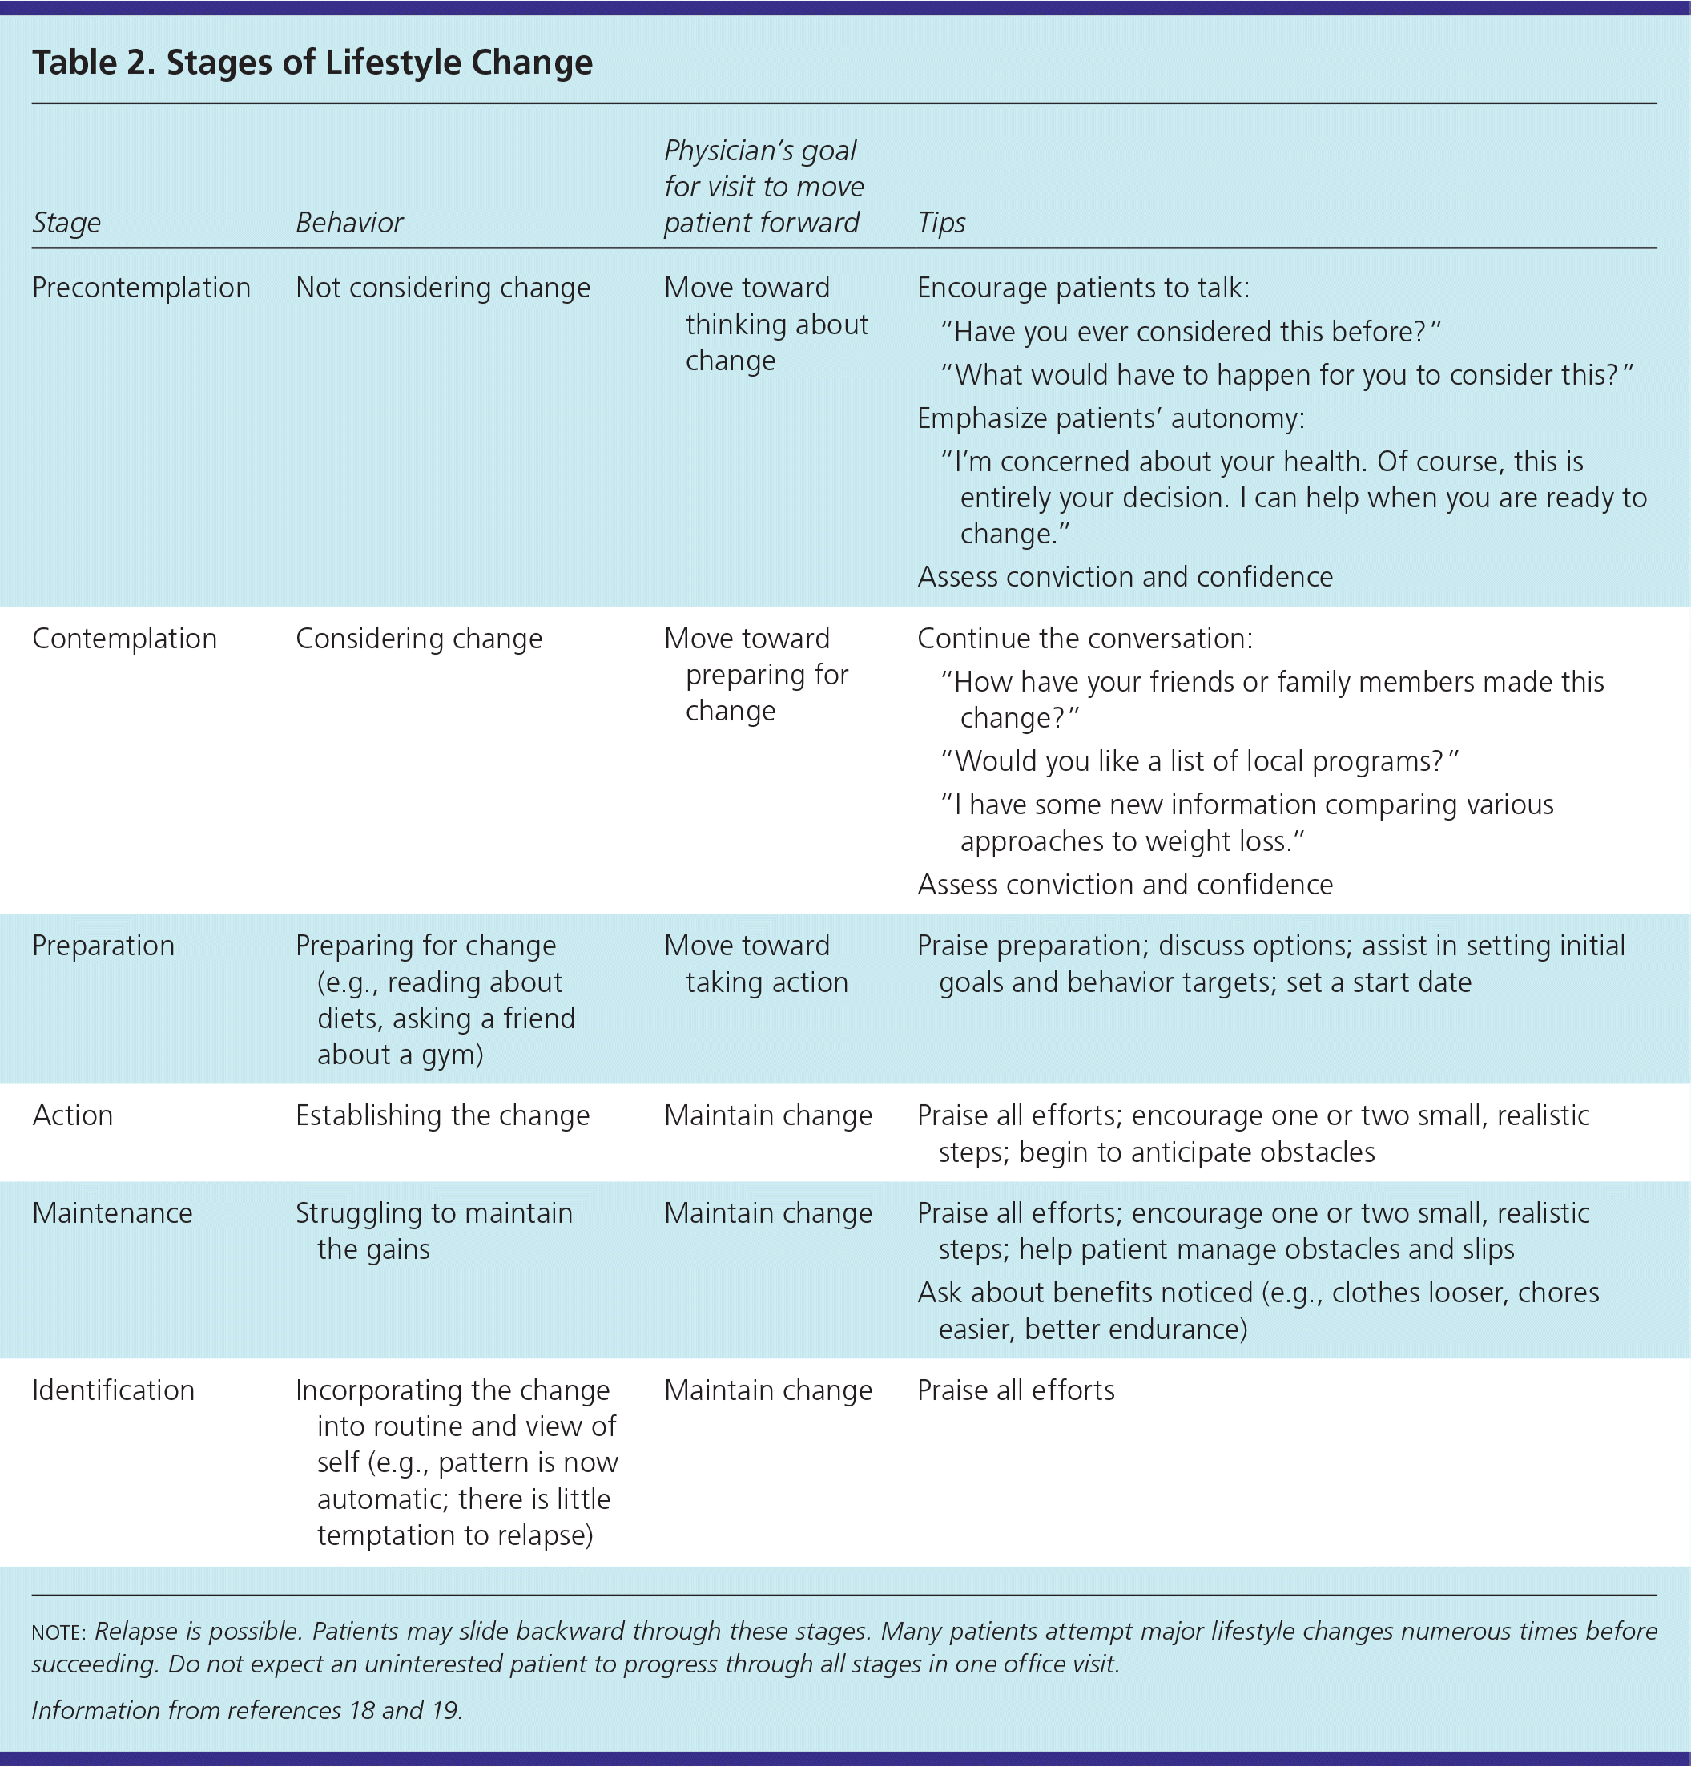

Slide 68
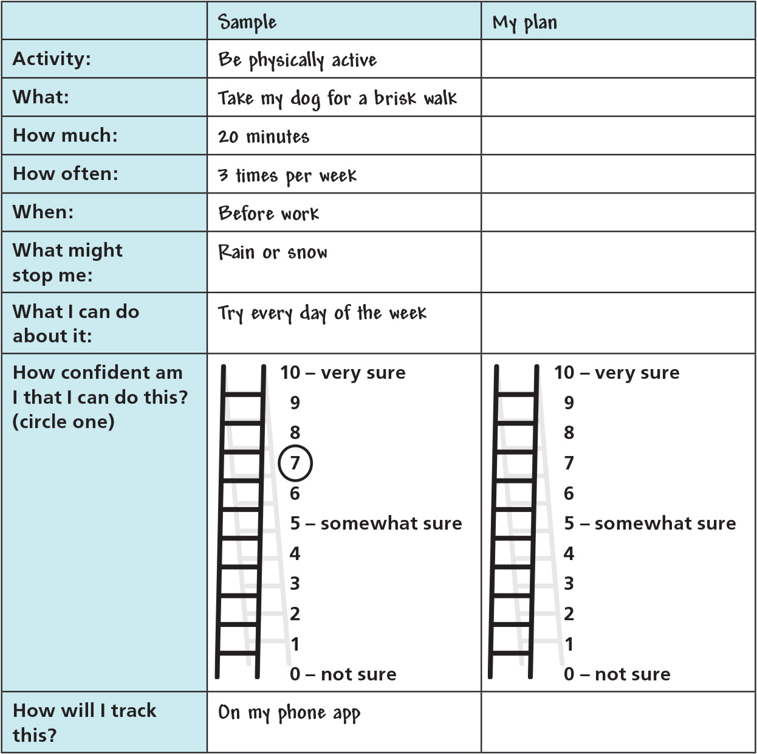

Slide 69
Thank You

