Slide 1
Special Populations Roundtable
Health Center COVID-19 Vaccine Program
April 23rd, 2021

Slide 2
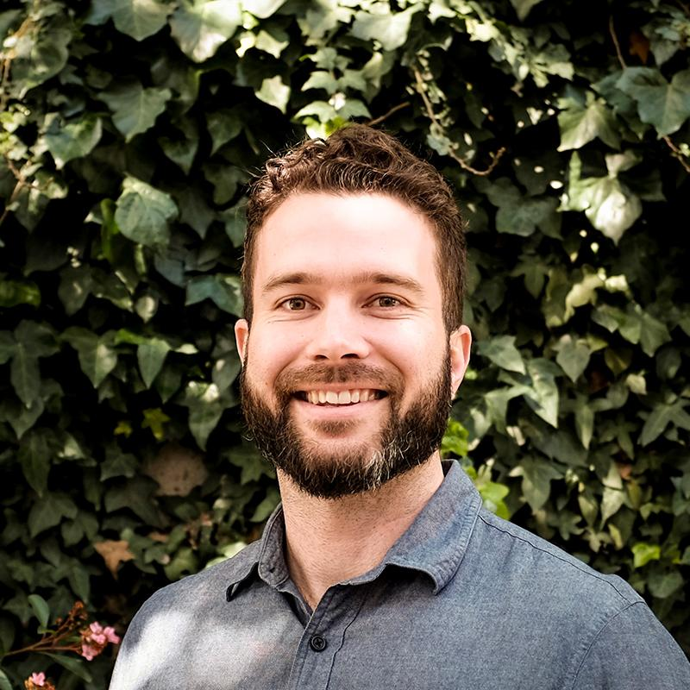
Today’s Facilitators
Liam Spurgeon
Project Manager
Health Outreach Partners
Alaina P. Boyer, PhD
Director of Research
National Healthcare for the Homeless Council
Notes:
Individual introductions

Slide 3
Today’s Agenda
Welcome and Introductions
Chat Icebreaker + Polls
BPHC Update: Suma Nair, PhD, MS, RD
Q&A with Suma
CDC Guest: Dr. Amanda Cohn, MD
Health Center Sharing: Promising Practices and Challenges
General Discussion
Conclusion
Topic: Vaccine Hesitancy
Notes:
Colleen

Slide 4
National Training and Technical Assistance Partners (NTTAPs)
Notes:
Colleen

Slide 5
HRSA COVID-19 FAQs
https://bphc.hrsa.gov/emergency-response/coronavirus-frequently-asked-questions?field_faq_category_tid=306&combine=
Notes:
Colleen

Slide 6
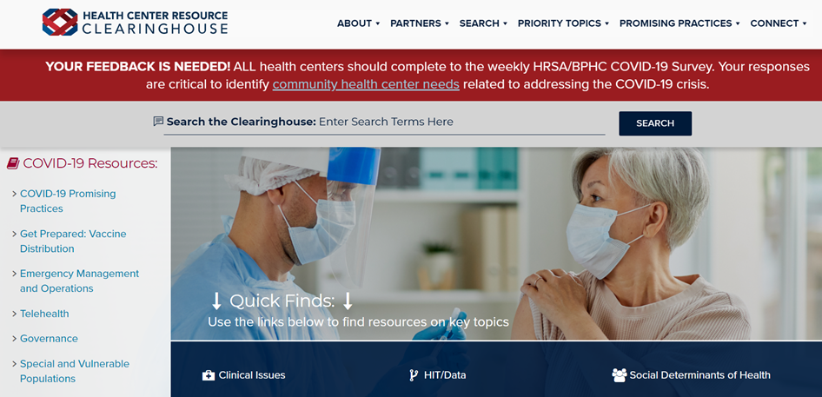
Health Center Resource Clearinghouse
www.healthcenterinfo.org
Notes:
Colleen

Slide 7
Zoom Etiquette
All participants muted upon entry
Cameras on (if possible)
Engage in chat
Raise hand if you would like to unmute
Notes:
Colleen

Slide 8
Next Roundtable: Friday, May 7th
Next roundtable will have a focus on peer- sharing
Be prepared with challenges, successes, lessons learned, and questions for your peers
This will be in addition to our regular agenda which includes BPHC updates
Final roundtable session will be on Friday, May 21st
Notes:
Colleen

Slide 9
Chat Icebreaker:
Name and role
Health center name
Health center location and no. of sites
Notes:
Gladys

Slide 10
Poll #1:
Did you attend the roundtable on April 9th?
Yes
No
Notes:
Gladys

Slide 11
Poll #2:
Are you using the BPHC Salesforce platform?
Yes
No
N/A
Notes:
Gladys

Slide 12
Poll #3:
What percentage of your health center staff have accepted a COVID-19 vaccine?
0-25%
26-50%
51-75%
76-100%
Unsure
Notes:
Glady

Slide 13
BPHC Update
Suma Nair, PhD, MS, RD Director, Office of Quality Improvement Bureau of Primary Health Care Health Resources and Services Administration
Notes:
Gladys to segway to BPHC speaker

Slide 14
Health Center COVID-19 Vaccine Program Special Populations Roundtable April 23, 2021
Suma Nair PhD, MS, RD
Director, Office of Quality Improvement
Bureau of Primary Health Care (BPHC)
Health Resources and Services Administration (HRSA)
Notes:
NGA

Slide 15
Health Center COVID-19 Vaccine Program Overview
HRSA and CDC partnership to directly allocate limited supply of COVID-19 vaccine
Separate federal allocation deployed in coordination with jurisdictions
Incrementally started at select HRSA-funded health centers that specialize in caring for particularly hard-to-reach and disproportionately affected populations.
All health centers and look-alikes invited to participate as of April 6th
All adults 16 and older now eligible to receive COVID19 vaccinations as of April 19th
“…equity is our North Star here.”
- Dr. Marcella Nunez-Smith,
Chair of the COVID-19 Health Equity Task Force
To see a list of invited and participating health centers,
visit https://www.hrsa.gov/coronavirus/health-center-program/participants.
Notes:
KRISTEN
President Biden has laid out a comprehensive National Strategy to tackle this pandemic.
The National Strategy utilizes all of the powers and resources of the federal government, working closely with state, local leaders, Tribal leaders, and those on the frontlines in communities across the country.
Community Health Centers are an important part of our broader strategy to ensure we are reaching everyone with our response. As Dr. Nunez-Smith, chair of the COVID-19 Health Equity Task Force mentioned during the White House press briefing with governors yesterday, equity is our north star….equity is the core to our strategy to put this pandemic behind us.
One of the goals of this program is to ensure our nation’s underserved communities and those disproportionately affected by COVID-19 are equitably vaccinated against COVID-19 – and that’s where all of you come in.
Health Centers provide primary care services in underserved communities across the country. There are almost 1400 Health Centers serving close to 30 million people across the country. Two-thirds of the population that these centers serve are living at or below the federal poverty line and 60% are racial and/or ethnic minorities.
To reach the most difficult to find populations, HRSA and CDC partnered to directly allocate limited supply of COVID-19 vaccine to HRSA-funded health centers.
With the activation of Phase 3, we are inviting all remaining health centers and look-alikes to participate in the program.
For a list of centers invited and those who have been ordering through the program, please see the link in the slide.

Slide 16
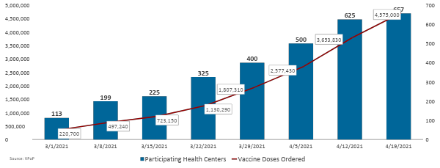
Health Center COVID-19 Vaccine Program Growth
To date, health centers have ordered 4,575,000 doses for 1,891 sites.

Slide 17
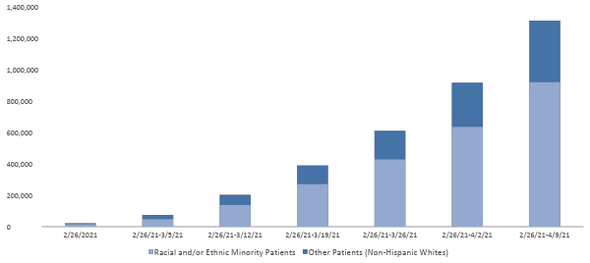
COVID-19 Vaccines Administered to Date by Health Centers: Race/Ethnicity Known
Health Center
COVID-19 Vaccine Program
Through the Health Center COVID-19 Vaccine Program, a total of 1,526,000 COVID-19 vaccine doses have been administered by participating health centers to date.
Source: Health Center COVID-19 Survey
Notes:
NOTES: There were a cumulative total of 1,526,000 COVID-19 vaccine doses that were administered by health centers through the COVID-19 Vaccine Program (February 26, 2021 - April 9, 2021). Of the 1, 311,089 vaccine doses to patients with known race and/or ethnicity, 919,187 doses were reported as known R/E minority patients (70% of cumulative total of COVID-19 vaccine doses administered by health centers). ​​
​​
As of April 3, 2021, 575 health centers and lookalikes are eligible to participate in the Health Center COVID-19 Vaccine Program. Of the 575 eligible health centers and lookalikes, 500 have placed an order for vaccines between February 26, 2021 - April 3, 2021 (87% of eligible Health Center COVID-19 Vaccine Program participants that placed an order for vaccines). There were 469 participating health centers and lookalikes that responded to the April 2, 2021 Health Center COVID-19 Vaccine Program survey Addendum (466 health centers and 3 lookalikes, which is 94% of participating health centers and lookalikes in the Health Center COVID-19 Vaccine program). ​​
​​
SOURCE: Health Center COVID-19 Weekly Survey, 2020-2021. ​​

Slide 18
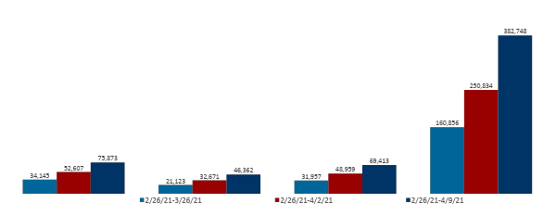
COVID-19 Vaccines Administered to Date by Health Centers: Special Populations
Health Center
COVID-19 Vaccine Program
Through the Health Center COVID-19 Vaccine Program,
a total of 1,526,000 COVID-19 vaccine doses have been administered
by participating health centers to date.
Patients with Limited English Proficiency:
25% (382,748) of doses
Migratory & Seasonal Agricultural
Workers:
5% (75,873) of doses
Patients Experiencing Homelessness:
3% (46,362) of doses
Patients Who Are Residents of Public Housing:
5% (69,413) of doses
Source: Health Center COVID-19 Survey

Slide 19
On the Horizon
Balancing primary care and pandemic response
Shifts in demand may necessitate
Increased outreach and engagement
Forming new partnerships to reach populations
Tailoring strategies to reach diverse segments of your target populations
Vaccinating Adolescents

Slide 20
Questions?
Notes:
NGA

Slide 21
Resources
TA Topic | Contact Information
BPHC Contact Form | https://bphccommunications.secure.force.com/ContactBPHC/BPHC_Contact_Form Select fourth category: “Health Center COVID-19 Vaccine Program”
Program Webpage | https://www.hrsa.gov/coronavirus/health-center-program
Program FAQs | https://bphc.hrsa.gov/emergency-response/coronavirus-frequently-asked-questions
Survey Questions | https://bphc.hrsa.gov/emergency-response/covid-19-survey-tools-questions
Primary Care Associations | https://bphc.hrsa.gov/qualityimprovement/strategicpartnerships/ncapca/associations.html
Immunization Program Managers | https://www.immunizationmanagers.org/page/MemPage

Slide 22
Thank You!
Bureau of Primary Health Care (BPHC)
Health Resources and Services Administration (HRSA)
For general information on the Health Center COVID-19 Vaccine Program, please visit: https://www.hrsa.gov/coronavirus/health-center-program.
bphc.hrsa.gov
Sign up for the Primary Health Care Digest

Slide 23
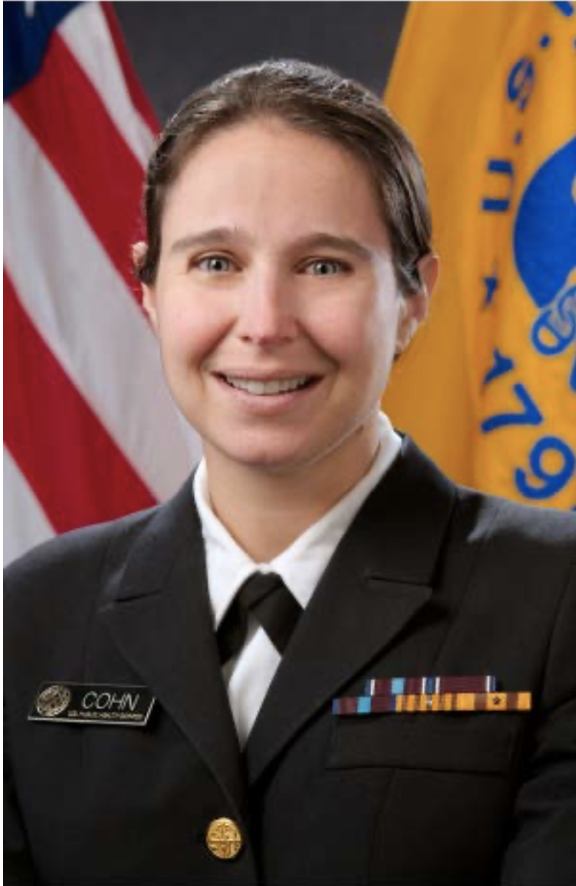
Special Guests
Capt. Amanda Cohn, MD
Chief Medical Officer, COVID-19 Vaccine Task Force
Executive Secretary, Advisory Committee on Immunization Practices
Chief Medical Officer, National Center for Immunization and Respiratory Diseases
CAPT, US Public Health Service
Centers for Disease Control and Prevention
Notes:
Colleen introduces

Slide 24
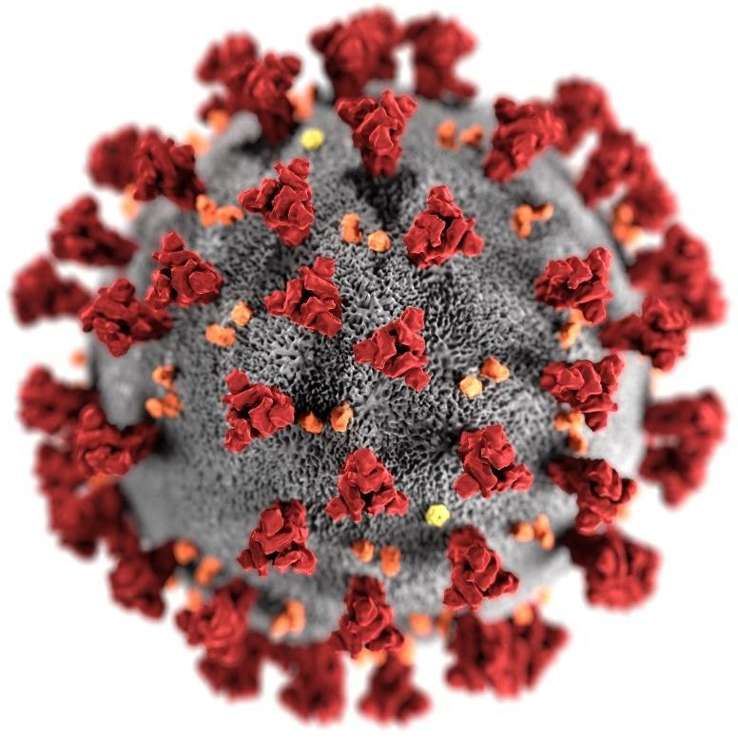
COVID-19 Vaccine Implementation
Amanda Cohn, MD CAPT, USPHS
April 23rd, 2021
For more information: www.cdc.gov/COVID19

Slide 25
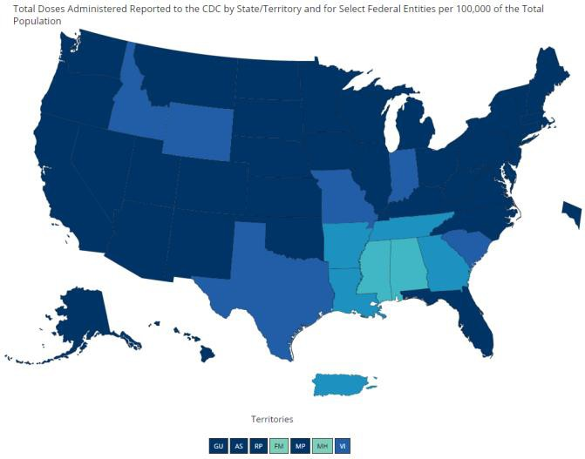
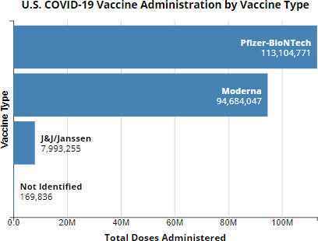
COVID-19 Vaccine Distribution and Initiation
As of April 21st, 2021
Available: https://covid.cdc.gov/covid-data-tracker

Slide 26
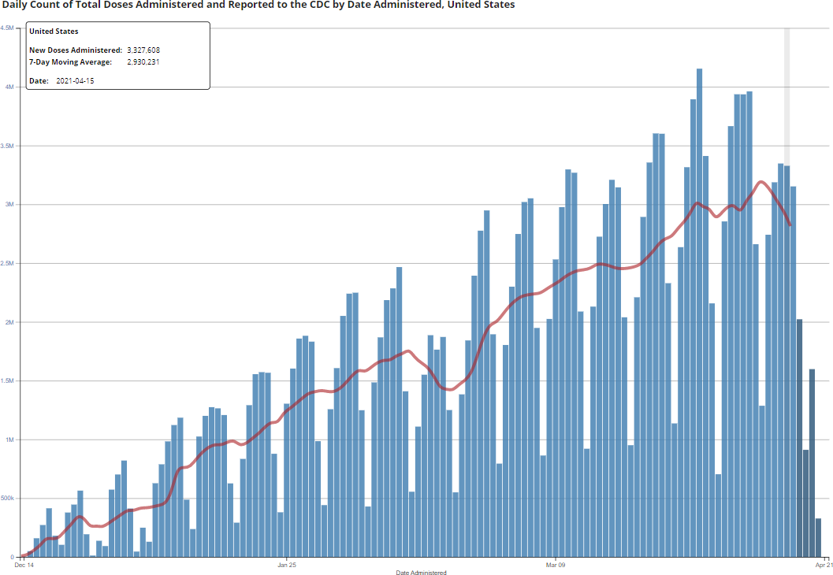
COVID-19 Vaccination Trends
Winter Storm Uri

Slide 27
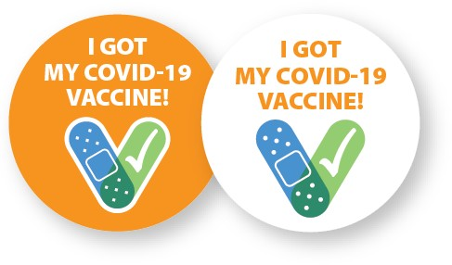
Currently Authorized Vaccines
Pfizer-BioNTech
Moderna
mRNA vaccine Require two doses
Johnson & Johnson/Janssen
Viral vector vaccine Requires one dose
All three vaccines were tested in tens of thousands of adults from diverse backgrounds, including older adults and communities of color.
All of the available vaccines have been proven effective at preventing serious illness, hospitalization, and death from COVID-19 disease.
It is unknown how long protection from vaccines might last.
https://www.pfizer.com/news/press-release/press-release-detail/pfizer-and-biontech-conclude-phase-3-study-covid-19-vaccine https://investors.modernatx.com/news-releases/news-release-details/modernas-covid-19-vaccine-candidate-meets-its-primary-efficacy

Slide 28
Safety of COVID-19 Vaccines is a Top Priority
COVID-19 vaccines are being held to the same safety standards as all vaccines.
Before Authorization
After Authorization
FDA carefully reviews all safety data from clinical trials.
ACIP reviews all safety data before
recommending use.
FDA and CDC closely monitor vaccine safety and side effects. There are systems in place that allow CDC and FDA to watch for safety issues.
V-safe: https://www.cdc.gov/coronavirus/2019-ncov/vaccines/safety/vsafe.html

Slide 30
The Problem: Need to Instill Vaccine Confidence
Overall acceptability of a COVID-19 vaccine is moderate¹
– Proportion intending to receive vaccine ranged across surveys: 42-86% (as of Nov-Dec 2020 polls)
COVID-19 vaccine more acceptable if:
Healthcare provider said it was safe
There are no costs to the individual It would help get back to school
and work
They could get it easily
Factors weighing on acceptance:
Concern about side effects
Efficacy
Risk perception
Associated costs
Tyson, A, Johnson, C, & Funk, C. (2020, September 17). U.S. Public Now Divided Over Whether To Get COVID-19 Vaccine. Pew Research Center. https://www.pewresearch.org/science/2020/09/17/u-s-public-now-divided-over- whether-to-get-covid-19-vaccine/
Jackson, C., & Newall, M. (2020, September 29). Despite COVID-19 spike, few individual behaviors are changing. Ipsos. https://www.ipsos.com/en-us/news-polls/axios-ipsos-coronavirus-index
1. APNORC; Harris; Fisher Ann Intern Med.; ICF; Kreps JAMA Netw Open.; Lazarus Nature Med.; Malik EClinicalMedicine.; Pogue Vaccines.; Reiter Vaccine.; Thunstrom SSRN. Axios-IPSOS. Pew. KFF. ABC News-IPSOS.
1/19/21

Slide 31
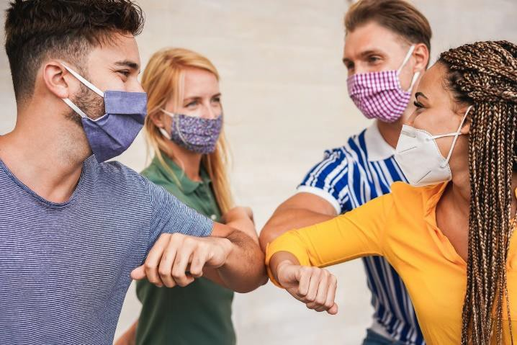
Disproportionately Affected Adult Populations Team
Goal to ensure equitable vaccination among disproportionately affected adult populations:
People with disabilities
People in long-term care facilities
People in detention centers/prisons
People with high-risk medical conditions
People experiencing homelessness
People in rural/remote areas
Racial/ethnic minorities
– Older adults
Photo source: iStock

Slide 32
COVID-19 and Persons Experiencing Homelessness (PEH)
Approximately 580,000 people are currently experiencing homelessness in the United States (HUD, 2020).
61% were staying in sheltered locations
39% were in unsheltered locations
Vaccination for people experiencing homelessness is important
Because many people who are homeless are older adults or have underlying medical conditions, they may also be at increased risk for severe illness.
Guidance for HCP for vaccination of homeless persons: Interim Guidance for Health Departments: COVID-19 Vaccination Implementation for People Experiencing Homelessness | CDC

Slide 33
Specific Challenges for PEH and PWUD/SUD
Vaccine appointments
Absence of some information should not be a barrier for vaccination
Limited access to technology
Vaccine administration
Combined strategies, including mobile clinics, will be most effective and efficient way to reach these populations
Documentation and subsequent dose follow-up (if two-dose vaccine used)
Innovative strategies may be needed
Vaccine side effects
Location where PEH and PWUD/SUD can recover from potential side effects

Slide 34
How to Ensure Receipt of all Recommended Doses
Vaccines that require a single dose are one option
Actions PEH and PWUD/SUD service providers can take to improve second dose follow-up:
Record up-to-date contact information, including back-up contact information or an alternate contact (with permission).
Ensure vaccine documentation (product, dose, location, date) is available to
vaccine providers across sites and geographic areas.
Provide multiple, easy-to-access opportunities to get a COVID-19 vaccine.
Integrate reminders into routine interactions.
Conduct outreach to connect with individuals who might otherwise be lost to follow-up.
https://www.cdc.gov/coronavirus/2019-ncov/community/homeless-shelters/vaccine-faqs.html

Slide 35
Special Considerations for Homebound Individuals
`
The risk of severe illness from COVID-19 increases with age
Older adults are, for the most part, very interested in getting vaccinated.
Older adults and People With Disabilities Need Accessible COVID-19 Vaccine Information.
Efforts are also needed to identify persons who need assistance.
New guidance is available to aid in vaccination of homebound persons: www.cdc.gov/vaccines/covid-19/clinical-considerations/homebound- persons.html.

Slide 36
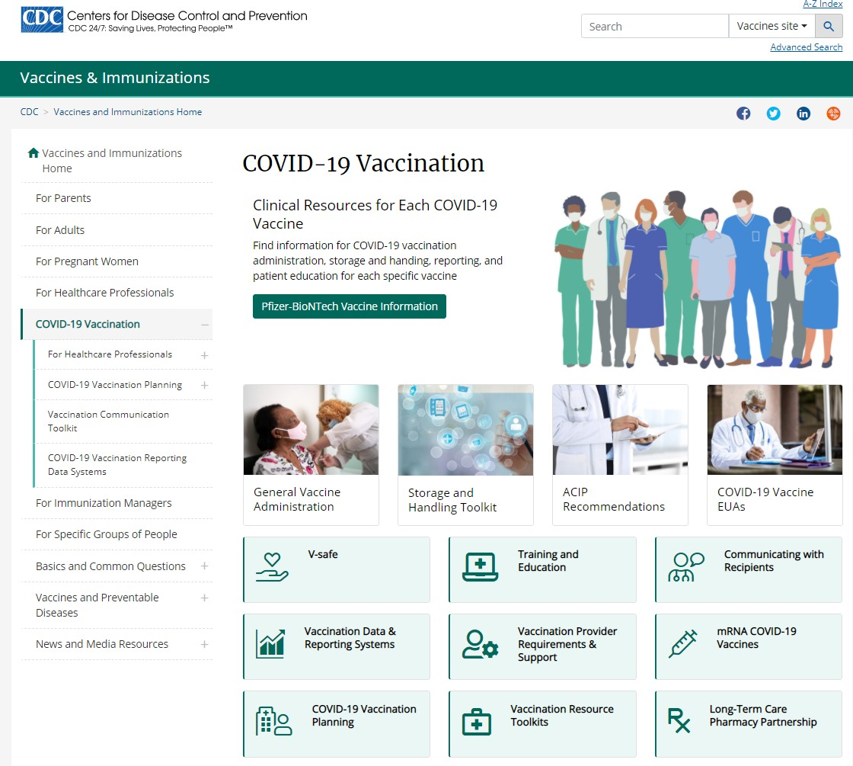
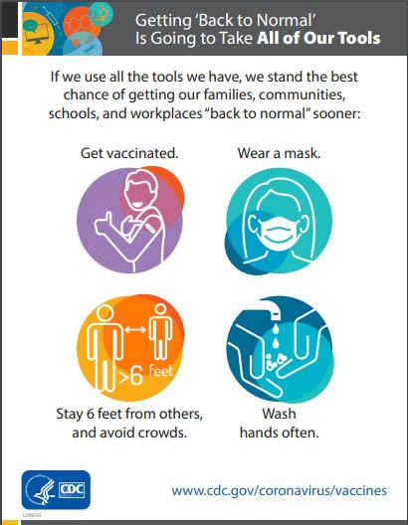
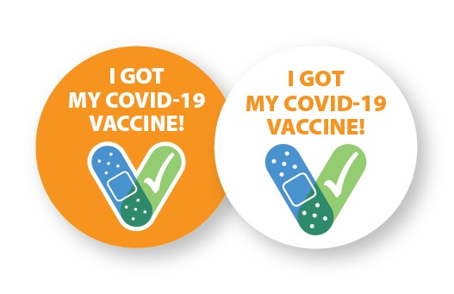
CDC Resources
Learn more with CDC’s COVID-19 vaccine tools and resources. Find information for COVID-19 vaccine administration, storage, reporting, patient education, and more.
COVID-19 Vaccination:
https://www.cdc.gov/vaccines/covid-19/index.html
For Healthcare Professionals: https://www.cdc.gov/vaccines/covid- 19/hcp/index.html
COVID-19 Vaccine Communication Toolkits
Medical Centers, Clinics, and Clinicians
Long-Term Care Facilities
Community-Based Organizations
Essential Workers
1/19/21

Slide 37
In Closing
The new vaccine programs bring vaccine to locations people trust.
It’s essential that people have access and trust that COVID-19 vaccines are safe and effective.
Confidence in the vaccination program is key; including trust in the vaccine, the vaccinator, and the system that produced it.
Reaching every individual who would benefit from vaccination is an important and ambitious goal – a goal that we can achieve by working together.

Slide 38
Thank you
For more information, contact CDC 1-800-CDC-INFO (232-4636)
TTY: 1-888-232-6348 www.cdc.gov
The findings and conclusions in this report are those of the authors and do not necessarily represent the official position of the Centers for Disease Control and Prevention.

Slide 39
Health Center Sharing: Promising Practices
North Carolina Farmworker Health Program
Health Center Sharing
Notes:
Colleen introduces

Slide 40
Poll #4:
What is the top priority for your health center this week?
Obtaining vaccines
Staffing to administer the vaccine
Staffing to support vaccine administration
Reporting to HRSA/other agencies
J&J pause
Vaccine hesitancy
Other (share in chat)
Notes:
Group discussion begins

Slide 41
How are you building confidence in the vaccines in your community?
General Discussion

Slide 42
How has the Johnson & Johnson pause created opportunities to educate patients or build confidence in the vaccines?
General Discussion
Notes:
Tag team discussion, gauge HC responses

Slide 43
How has the reasoning for vaccine hesitancy in your community been widely shared or nuanced from patient to patient?
General Discussion

Slide 44
What additional support do you need to prepare for or implement your vaccine program?
General Discussion

Slide 45
Additional Questions + Resource Sharing

Slide 46
Resources
NACHC Weekly COVID-19 Survey Infographic
Infographics: National Findings on Health Centers' Response to COVID-19
NCHPH Public Housing Primary Care Dashboard http://nchph.org/DASHBOARD/
NCFH COVID-19 web page
COVID-19 - NATIONAL CENTER FOR FARMWORKER HEALTH (ncfh.org)
Translated Materials Library (NRC-RIM)
https://nrcrim.umn.edu/health-education/translated-materials-library
Farmworker Justice COVID-19 page
http://www.farmworkerjustice.org/advocacy_program/covid-19/

Slide 47
Resources (cont.)
COVID-19 Homeless System Response: Vaccine Planning and Distribution- HUD: https://www.hudexchange.info/resource/6229/covid19-homeless-system-response-vaccine-planning-and-distribution/
COVID-19 Resources for Health Centers Serving People Experiencing Homelessness https://nhchc.org/clinical-practice/diseases-and-conditions/influenza/
Council C-19 Flash Blast https://nhchc.org/council-covid-19-flash-blast/
Infographic on the Vaccine https://nhchc.org/wp-content/uploads/2021/02/COVID-19-Infographic-3.pdf
Letter to Governors and Local Officials: Increasing COVID-19 Vaccine Access for People Experiencing Homelessness
COVID-19 Resources for Asian American-, Native Hawaiian-, and Pacific Islander-Serving Community Health Centers: http://coronavirus.aapcho.org/

Slide 48
Next Roundtable:
Friday, May 7, 2021
Be prepared with challenges, successes, lessons learned, and questions for your peers!

