Slide 1
Special Populations Roundtable
Health Center COVID-19 Vaccine Program
April 9, 2021

Slide 2
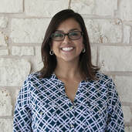
Today’s Facilitators
Colleen Velez
Director of Federal TA
Corporation of Supportive Housing
Gladys Carrillo, LCSW
Director of Program Services
National Center for Farmworker Health
Notes:
Individual introductions

Slide 3
Today’s Agenda
Welcome and Introductions
Chat Icebreaker + Polls
Introduction of Special Guest
BPHC Update: Suma Nair, PhD, MS, RD
Q&A with Suma
Special Guests: Workforce NTTAPs
Health Center Sharing: Promising Practices and Challenges
General Discussion
Conclusion
Topic: Workforce/Staffing
Notes:
Colleen

Slide 4
National Training and Technical Assistance Partners (NTTAPs)
Notes:
Colleen

Slide 5
HRSA COVID-19 FAQs
https://bphc.hrsa.gov/emergency-response/coronavirus-frequently-asked-questions?field_faq_category_tid=306&combine=
Notes:
Colleen

Slide 6
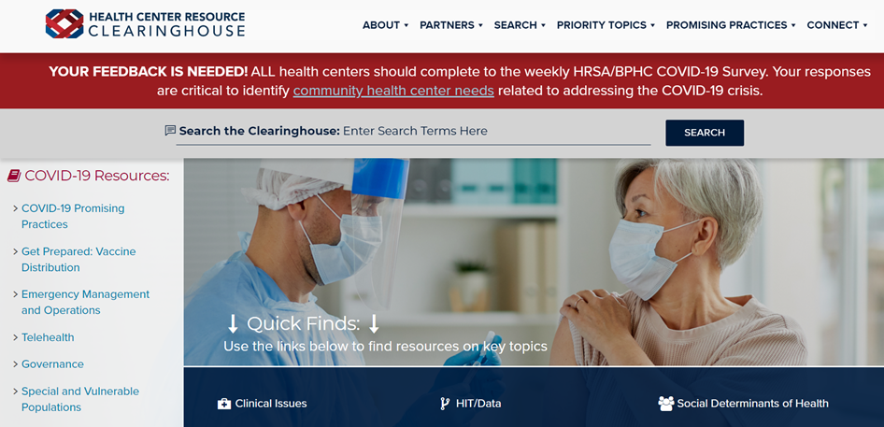
Health Center Resource Clearinghouse
www.healthcenterinfo.org
Notes:
Colleen

Slide 7
Zoom Etiquette
All participants muted upon entry
Cameras on (if possible)
Engage in chat
Raise hand if you would like to unmute
Notes:
Colleen

Slide 8
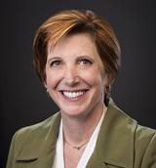
Guest Speaker on Friday, April 23rd
Dr. Nancy Messonnier, MD
Director of CDC’s National Center for Immunization and Respiratory Diseases (NCIRD)
Currently leading CDC’s efforts on COVID-19 vaccine.
Notes:
Colleen

Slide 9
Chat Icebreaker:
Name and role
Health center name
Health center location and no. of sites
Notes:
Gladys

Slide 10
Poll #1:
Did you attend the roundtable on March 26th?
Yes
No
Notes:
Gladys

Slide 11
Poll #2:
Are you using the BPHC Salesforce platform?
Yes
No
N/A
Notes:
Gladys

Slide 12
Poll #3:
What percentage of your health center staff have accepted a COVID-19 vaccine?
0-25%
26-50%
51-75%
76-100%
Unsure
Notes:
Glady

Slide 13
BPHC Update
Suma Nair, PhD, MS, RD Director, Office of Quality Improvement Bureau of Primary Health Care Health Resources and Services Administration
Notes:
Gladys to segway to BPHC speaker

Slide 14
Special Guests
The Association of Clinicians for the Underserved (ACU)
The Weitzman Institute (CHC, Inc.)
Notes:
Colleen introduces

Slide 15
Health Center Sharing: Promising Practices
North Texas Area Community Health Center
Health Center Sharing
Notes:
Colleen introduces

Slide 16
Poll #4:
What is the top priority for your health center this week?
Obtaining vaccines
Expanding vaccine eligibility
Reporting to HRSA/other agencies
Vaccine hesitancy
Other (share in chat)
Notes:
Group discussion begins

Slide 17
What has been a top challenge in supporting staff you prepare for/implement your vaccine program?
General Discussion
Notes:
Tag team discussion, gauge HC responses

Slide 18
What strategies have you used to address this challenge?
General Discussion

Slide 19
What has been a top success in supporting staff as you prepare for/implement your vaccine program?
General Discussion

Slide 20
What were the key contributing factors to this success?
General Discussion

Slide 21
What additional support do you need to prepare for or implement your vaccine program?
General Discussion

Slide 22
Additional Questions + Resource Sharing

Slide 23
Resources
NACHC Weekly COVID-19 Survey Infographic
Infographics: National Findings on Health Centers' Response to COVID-19
NCHPH Public Housing Primary Care Dashboard http://nchph.org/DASHBOARD/
NCFH COVID-19 web page
COVID-19 - NATIONAL CENTER FOR FARMWORKER HEALTH (ncfh.org)
Translated Materials Library (NRC-RIM)
https://nrcrim.umn.edu/health-education/translated-materials-library
Farmworker Justice COVID-19 page
http://www.farmworkerjustice.org/advocacy_program/covid-19/

Slide 24
Resources (cont.)
COVID-19 Homeless System Response: Vaccine Planning and Distribution- HUD: https://www.hudexchange.info/resource/6229/covid19-homeless-system-response-vaccine-planning-and-distribution/
COVID-19 Resources for Health Centers Serving People Experiencing Homelessness https://nhchc.org/clinical-practice/diseases-and-conditions/influenza/
Council C-19 Flash Blast https://nhchc.org/council-covid-19-flash-blast/
Infographic on the Vaccine https://nhchc.org/wp-content/uploads/2021/02/COVID-19-Infographic-3.pdf
Letter to Governors and Local Officials: Increasing COVID-19 Vaccine Access for People Experiencing Homelessness
COVID-19 Resources for Asian American-, Native Hawaiian-, and Pacific Islander-Serving Community Health Centers: http://coronavirus.aapcho.org/

Slide 25
Next Roundtable:
Friday, April 23, 2021

