Slide 1
Special Populations Roundtable
Health Center COVID-19 Vaccine Program
March 12, 2021

Slide 2
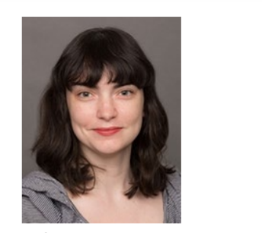
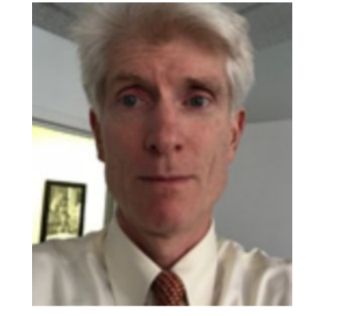
Today’s Facilitators
Bob Burns, MPA
Director National Center for Health in Public Housing
Emily Kane, MPA
Senior Program Manager
National Nurse-Led Care Consortium

Slide 3
Today’s Agenda
Welcome and Introductions
Chat Icebreaker + Polls
Introduction of Special Guest
BPHC Update: Suma Nair, PhD, MS, RD
Q&A with Suma
Health Center Sharing: Promising Practices and Challenges
General Discussion
Conclusion
Topic: Vaccine Supply and Distribution

Slide 4
National Training and Technical Assistance Partners (NTTAPs)

Slide 5
HRSA COVID-19 FAQs
https://bphc.hrsa.gov/emergency-response/coronavirus-frequently-asked-questions?field_faq_category_tid=306&combine=

Slide 6
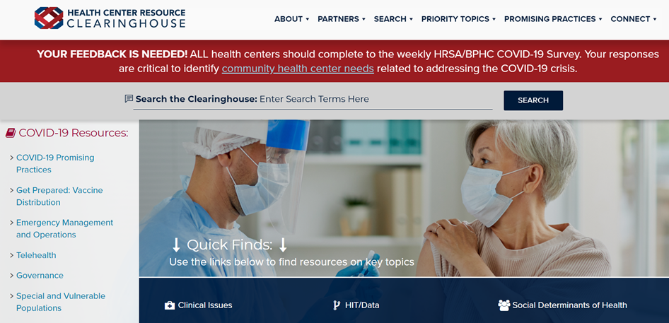
Health Center Resource Clearinghouse
www.healthcenterinfo.org

Slide 7
Zoom Etiquette
All participants muted upon entry
Cameras on (if possible)
Engage in chat
Raise hand if you would like to unmute

Slide 8
Chat Icebreaker:
Name and role
Health center name
Health center location and no. of sites

Slide 9
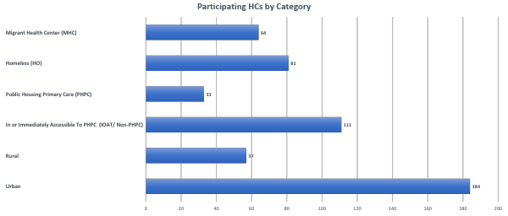
Health Center COVID-19 Vaccine Program Initial 250 HCs, Cohorts 1,2 & 3
Source: UDS 2019
Notes:
Flu LEAD: 4
228 vs. 250 CHCs explanation:
The total for CHC funding category only reflects Health Centers that have reported “True” CHC funding according to UDS 2019. The 22 remaining vaccination sites not included in the count are those that have reported False for CHC funding in UDS or weren’t matched.

Slide 10
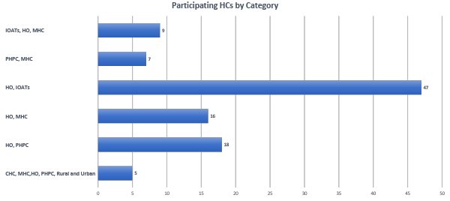
Health Center COVID-19 Vaccine Program Initial 250 HCs, Cohorts 1,2 & 3
Source: UDS 2019

Slide 11
Health Center COVID-19 Vaccine Program Initial 250 HCs, Cohorts 1,2 & 3
Patients Best Served in a Language Other than English
All CHC Vaccine Program Sites Total: 4,164,384
Source: National Health Center Data

Slide 12
Poll #1:
Would you be interested in participating in topic or population-specific breakout sessions in future roundtables?

Slide 13
Poll #2:
Which topic would you like to see covered in the next roundtable?
Vaccine confidence
Partnerships
Staffing
Reimbursement
Outreach and Messaging
Other (share in chat)

Slide 14
Poll #3:
(Select all that apply.) What subject matter experts/partners would you like to hear from during the roundtable discussions?
Centers for Disease Control
Centers for Medicare and Medicaid
Primary Care Associations
U.S. Department of Housing and Urban Development
Other (please note in chat)

Slide 15
Poll #4:
(Select all that apply.) Which special population(s) does your health center serve?
Migratory/Seasonal Agricultural Workers
Individuals Experiencing Homelessness
Residents of Public Housing
Individuals with Limited English Proficiency
None of these
Other (please note in chat)

Slide 16
BPHC Update
Suma Nair, PhD, MS, RD Director, Office of Quality Improvement Bureau of Primary Health Care Health Resources and Services Administration

Slide 17
Health Center Sharing: Promising Practices
Project Hope
Community Health Centers of the Central Coast, Inc.
Yakima Neighborhood Health Services
AxessPointe
Health Center Sharing

Slide 18
What has been a top challenge for you in preparing for or implementing your vaccine program?
General Discussion

Slide 19
What strategies have you used to address this challenge?
General Discussion

Slide 20
What has been a top success that you have experience in preparing for or implementing your vaccine program?
General Discussion

Slide 21
What were the key contributing factors to this success?
General Discussion

Slide 22
What additional support do you need to prepare for or implement your vaccine program?
General Discussion

Slide 23
Poll:
Would you be interested in participating in roundtable discussions beyond April 9th?

Slide 24
Poll:
What is your preferred length for our roundtable discussions?

Slide 25
Additional Questions + Resource Sharing

Slide 26
Resources
NACHC Weekly COVID-19 Survey Infographic
Infographics: National Findings on Health Centers' Response to COVID-19
NCHPH Public Housing Primary Care Dashboard http://nchph.org/DASHBOARD/
NCFH COVID-19 web page
COVID-19 - NATIONAL CENTER FOR FARMWORKER HEALTH (ncfh.org)
Translated Materials Library (NRC-RIM)
https://nrcrim.umn.edu/health-education/translated-materials-library
Farmworker Justice COVID-19 page
http://www.farmworkerjustice.org/advocacy_program/covid-19/

Slide 27
Resources (cont.)
COVID-19 Homeless System Response: Vaccine Planning and Distribution- HUD: https://www.hudexchange.info/resource/6229/covid19-homeless-system-response-vaccine-planning-and-distribution/
COVID-19 Resources for Health Centers Serving People Experiencing Homelessness https://nhchc.org/clinical-practice/diseases-and-conditions/influenza/
Council C-19 Flash Blast https://nhchc.org/council-covid-19-flash-blast/
Infographic on the Vaccine https://nhchc.org/wp-content/uploads/2021/02/COVID-19-Infographic-3.pdf
Letter to Governors and Local Officials: Increasing COVID-19 Vaccine Access for People Experiencing Homelessness

Slide 28
Next Roundtable:
Friday, March 26, 2021

