Slide 1
Special Populations Roundtable
Health Center COVID-19 Vaccine Program
March 26, 2021

Slide 2
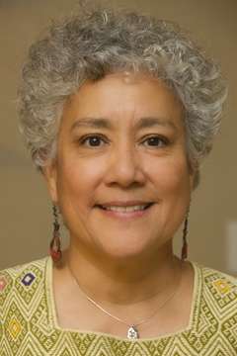
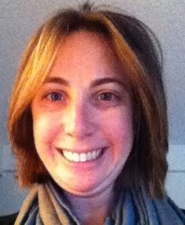
Today’s Facilitators
Deliana Garcia, MA
Director, International Projects and Emerging Issues Migrant Clinicians Network
Alexis Guild, MPP
Director of Health Policy and Programs Farmworker Justice

Slide 3
Today’s Agenda
Welcome and Introductions
Chat Icebreaker + Polls
Introduction of Special Guest
BPHC Update: Suma Nair, PhD, MS, RD
Q&A with Suma
Special Guest: Belen Moran Bradley
Health Center Sharing: Promising Practices and Challenges
General Discussion
Conclusion
Topic: Outreach and Messaging

Slide 4
National Training and Technical Assistance Partners (NTTAPs)

Slide 5
HRSA COVID-19 FAQs
https://bphc.hrsa.gov/emergency-response/coronavirus-frequently-asked-questions?field_faq_category_tid=306&combine=

Slide 6
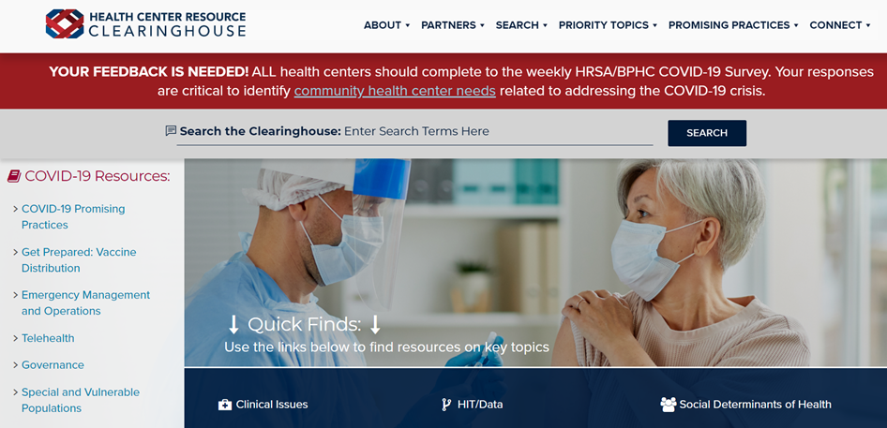
Health Center Resource Clearinghouse
www.healthcenterinfo.org

Slide 7
Zoom Etiquette
All participants muted upon entry
Cameras on (if possible)
Engage in chat
Raise hand if you would like to unmute

Slide 8
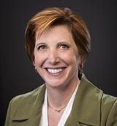
Guest Speaker on Friday, April 23rd
Dr. Nancy Messonnier, MD
Director of CDC’s National Center for Immunization and Respiratory Diseases (NCIRD)
Currently leading CDC’s efforts on COVID-19 vaccine.

Slide 9
Chat Icebreaker:
Name and role
Health center name
Health center location and no. of sites

Slide 10
Poll #1:
Did you attend the roundtable on March 12th?
Yes
No

Slide 11
Poll #2:
Have you been able to obtain a waiver from your state to vaccinate your patients outside of state-specific groups?
Yes
No
Unsure

Slide 12
Poll #3:
Are you using the BPHC Salesforce platform?
Yes
No
N/A

Slide 13
Poll #4:
What percentage of your health center staff have accepted a COVID-19 vaccine?
0-25%
26-50%
51-75%
76-100%
Unsure

Slide 14
Poll #5:
What is the top priority for your health center this week?
Obtaining vaccines
Expanding vaccine eligibility
Reporting to HRSA/other agencies
Vaccine hesitancy
Other (share in chat)

Slide 15
Poll #6:
Which topic would you like to see covered in the next roundtable?
Vaccine confidence
Partnerships
Staffing
Reimbursement
Other (share in chat)

Slide 16
Poll #7:
(Select all that apply.) Which special population(s) does your health center serve?
Migratory/Seasonal Agricultural Workers
Individuals Experiencing Homelessness
Residents of Public Housing
Individuals with Limited English Proficiency
None of these
Other (please note in chat)

Slide 17
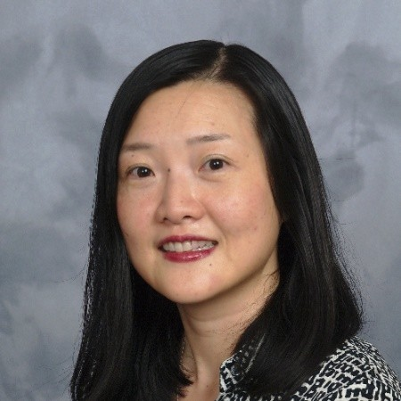
BPHC Update
Sue Lin, PhD, MS Deputy Office Director at Health Resources and Services Administration Health Resources and Services Administration

Slide 18
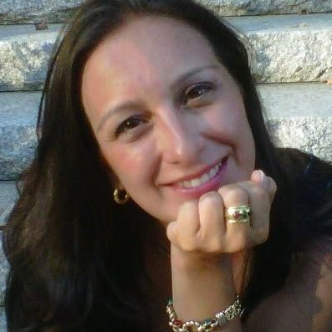
Special Guest
Belen Moran Bradley Press Officer/Public Affairs Center for Global Health Centers for Disease Control and Prevention

Slide 19
CDC COVID-19 Vaccine Communication: Building Vaccine Confidence
Belen Moran Bradley
Sr. Health Communication Specialist
Vaccine Task Force, Communications Team
CDC COVID-19 Response
March 26, 2021

Slide 20
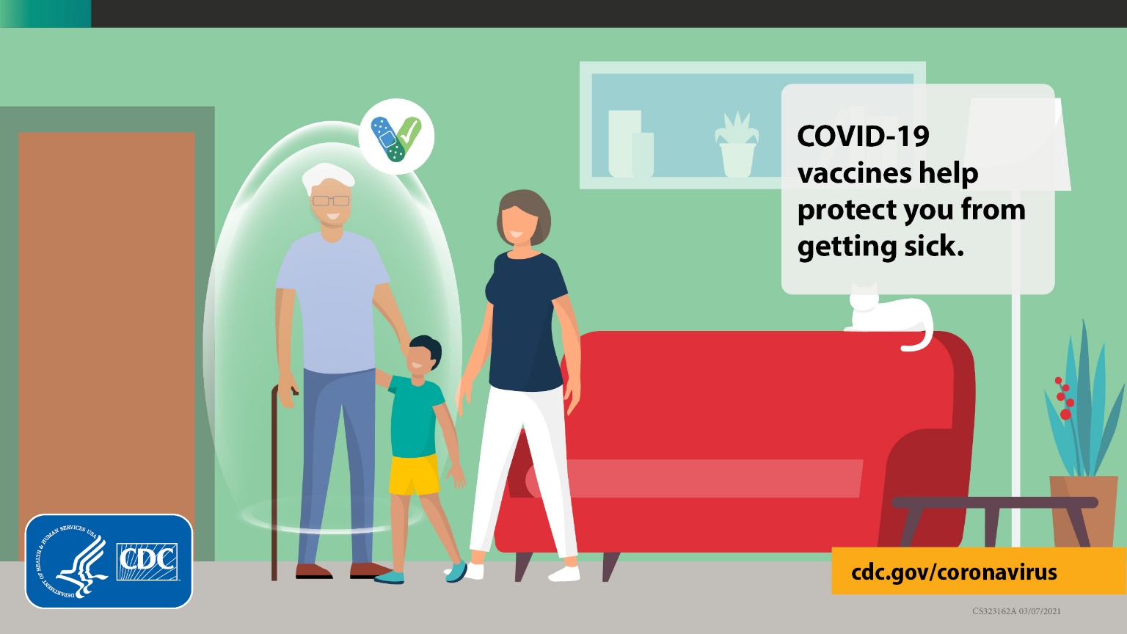
Agenda
Program overview
Communication to build confidence
Community
Consumer
Looking ahead

Slide 21
Program Overview

Slide 22
Communication Goals and Objectives
Increase acceptance, confidence, and uptake of the COVID-19 vaccine:
​
Boost and maintain trust
Promote CDC COVID-19 vaccine information, resources, and recommendations
Notes:
Increase acceptance, confidence, and uptake of the COVID-19 vaccine with information that is timely; clear, culturally and linguistically appropriate, accurate, relevant, and actionable​
Boost and maintain trust:
In CDC’s vaccine messaging through third party validators​
With a special emphasis on medical providers, governmental entities and impacted communities (especially those communities that have historically had harmful experiences with providers and/or government)​
Promote CDC COVID-19 vaccine information, resources, and recommendations

Slide 23
Defining Vaccine Confidence
Vaccine confidence is the trust in:
Recommended vaccines;
Providers who administer vaccines;
Processes and policies that lead to vaccine development, licensure, manufacturing, and recommendations for use.
Notes:
Crisis communication requires people to do things that are counter intuitive.
Communications activities and outreach efforts related to the COVID-19 vaccine depend on vaccine confidence.
We define vaccine confidence as the trust that parents, patients, or providers have in:
recommended vaccines;
providers who administer vaccines; and
processes and policies that lead to vaccine development, licensure, manufacturing, and recommendations for use
This foundation of trust is critical.

Slide 24
Key CDC Messages
You can help stop the pandemic by getting a COVID-19 vaccine.
Get the information you need to choose to get vaccinated when it is your turn.
COVID-19 vaccines are safe and effective.
COVID-19 vaccine will be free for you.
After COVID-19 vaccination, you might have some side effects. These are normal signs that your body is building protection.
You will still need to take precautions in public, like wearing a well-fitted mask and practicing physical distancing for now.

Slide 25
Key Components of CDC’s Communication Work
Research and evaluation
Outreach to populations disproportionately affected by COVID-19
Professional education and engagement
Vaccine safety and effectiveness messaging
Responds to public inquiries
Supports vaccine programs – public health and partners
Strong foundation in Crisis & Emergency Risk Communication (CERC)
Comprehensive approach to build and reinforce vaccine confidence

Slide 26
Communication to build confidence

Slide 27
It's our job to let communities know that it's okay and valid to have questions, especially for those who have been hurt by societal systems.
Notes:
It’s our job to let communities know that it is okay and valid to have questions, and especially for those communities that have been hurt by societal systems.
Longstanding inequities in access to health and social services, an ugly history of medical experimentation, forced sterilization, systematic racism and recent experiences with COVID-19 which have hit communities of color particularly hard, all result in low confidence in vaccines.
We know that undocumented people may also be afraid to get vaccinated.

Slide 28
Trusted Partnerships Matter:
COVID-19 Facilitating Acceptance with Community-Based Trusted Messengers (FACT) Alliance strengthens intersectoral partnerships to support vaccine confidence in communities. Focuses on:
Community Health Workers
Pharmacists
Nurses
Faith Leaders
Aligned with the guiding principles to CDC COVID-19 Response Health Equity Strategy
1/07/21
Notes:
CDC will be leading the FACT Alliance to collaborate with trusted key messengers who can help bridge the gap between the government and communities of color on creating appropriate messages, materials and promote promising solutions to build vaccine confidence.
CDC will fund minority-led national organizations including minority-led professional associations. Some of these organizations will provide subgrants to local chapters to support community-level action.
We will also support our established network of funded recipients that include local health departments, CBOs, FQHCs, within our immunization and community help programs to focused on vaccine awareness, access, and confidence.
Funding will also support national-level organizations to provide support to local branches/chapters and community-based organizations, as well as deploy vaccination educational campaigns as part of their broader communications strategies.
We hope to be able to work with you all on this initiative.
Again, this work aligns with the guiding principles in CDC’s COVID-19 Response Health Equity Strategy.

Slide 29
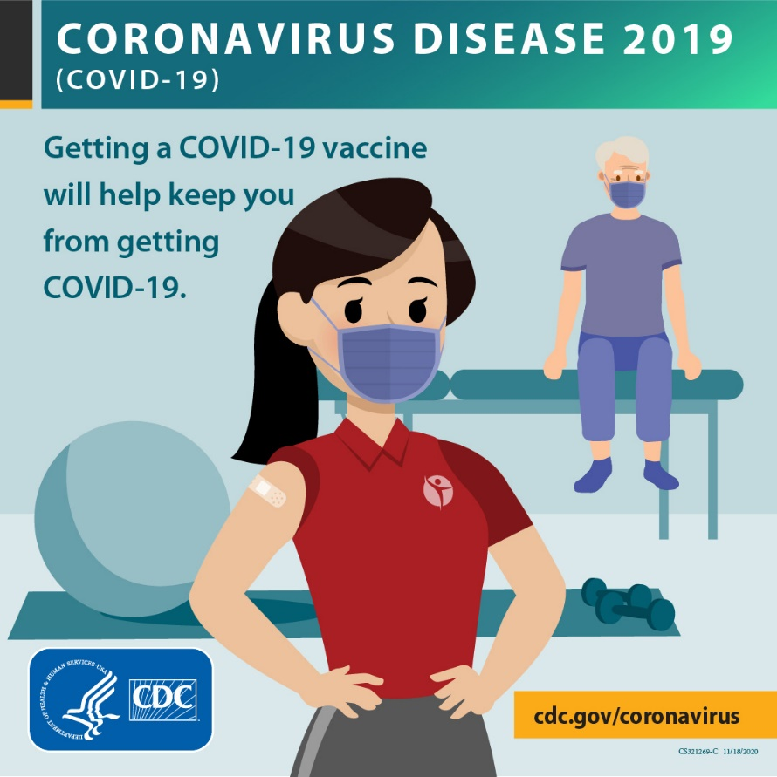
Community and partner engagement
To understand vaccination concerns, challenges, needs and successes of specific groups and address them, CDC is:
Conducting listening sessions with community partners
Engaged in (funded and unfunded) partnerships with national/state/local organizations and partners to understand
Participating in webinars and townhalls

Slide 30
Resources to support you
Technical assistance
Web
Toolkits
Messages
www.cdc.gov/coronavirus/2019-ncov/vaccines/index.html

Slide 31
COVID-19 Vaccine Communication Toolkits
Key messages
Frequently asked questions (FAQ)
Slide deck
Plain language fact sheet in several languages
“I got my COVID-19 vaccine!” stickers
Customizable newsletter content
Customizable letters
Social media image and sample messages
Posters
www.cdc.gov/coronavirus/2019-ncov/vaccines/toolkits.html
Notes:
We have a several audience-specific communications toolkits to help organizations promote covid-19 vaccine. The toolkit contains a variety of resources which include: Key messages, slides decks, FAQ’s, flyers etc

Slide 32
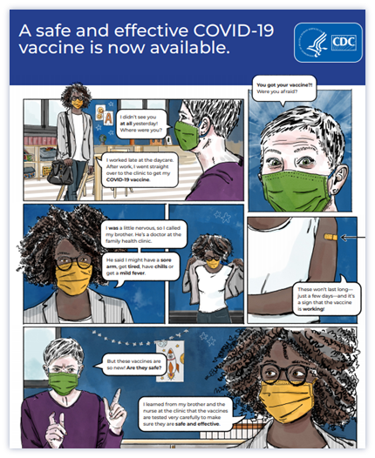
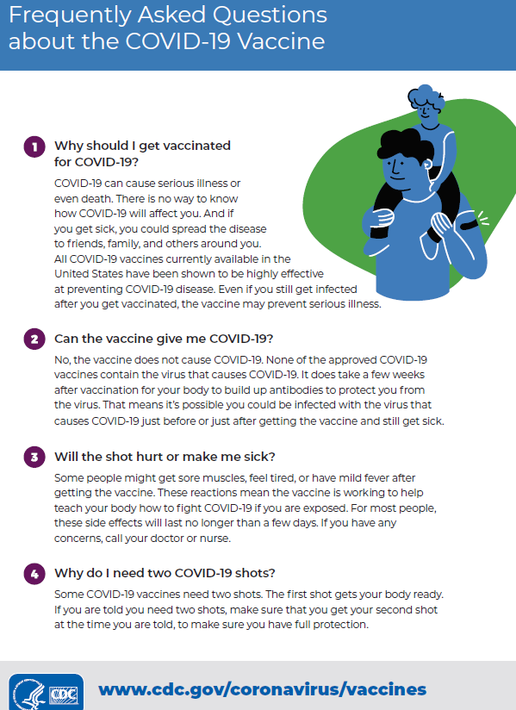
COVID-19 Vaccine Communication Toolkit Materials
www.cdc.gov/coronavirus/2019-ncov/vaccines/toolkits/community-organization.html
Notes:
Slides

Slide 33
COVID-19 Vaccine Communication Toolkit Materials
www.cdc.gov//coronavirus2019-ncov/vaccines/toolkits/community-organization.html

Slide 34
COVID-19 Vaccine Communication Toolkits
One-Stop Shop Toolkits: www.cdc.gov/coronavirus/2019ncov/communication/toolkits/index.html
People Experiencing Homelessness
www.cdc.gov/coronavirus/2019-ncov/community/homeless-shelters/index.html
Tribal Communities
www.cdc.gov/coronavirus/2019-ncov/community/tribal/social-distancing.html
Community Organizations
www.cdc.gov/coronavirus/2019-ncov/community/organizations/community-based.html

Slide 35
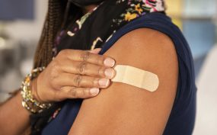
Call to action: #sleeveup
The COVID-19 vaccine is an important prevention tool for stopping the pandemic.
You are on the front lines of keeping our communities healthy.
You can help communities disproportionately affected by COVID-19 feel confident and safe in their decision to get vaccinated.
Notes:
Add the source for photos

Slide 36
Upcoming materials
Vaccine infographics
Additional photos and posters
Vaccine community features
Matte articles
How-to guides
Vaccine rollout to the larger population
Changes in mitigation recommendations
New vaccines and audiences for whom vaccines may be recommended

Slide 37
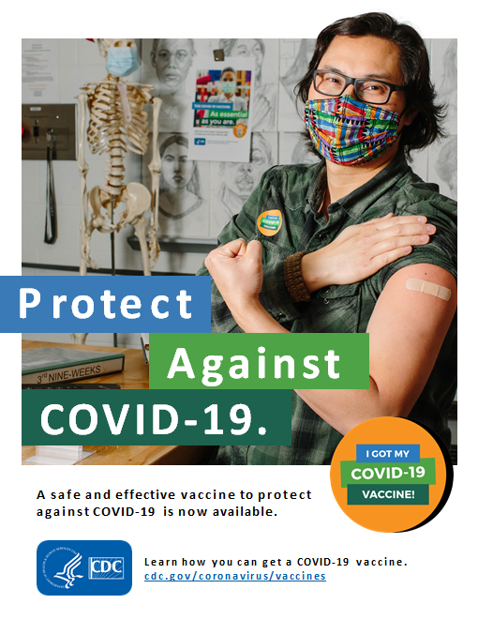
Thank you

Slide 38
Health Center Sharing: Promising Practices
La Maestra Community Health Centers
Health Center Sharing

Slide 39
What has been a top challenge in conducting outreach and messaging as you prepare for/implement your vaccine program?
General Discussion

Slide 40
What strategies have you used to address this challenge?
General Discussion

Slide 41
What has been a top success in conducting outreach and messaging as you prepare for/implement your vaccine program?
General Discussion

Slide 42
What were the key contributing factors to this success?
General Discussion

Slide 43
What additional support do you need to prepare for or implement your vaccine program?
General Discussion

Slide 44
Poll:
Would you be interested in participating in roundtable discussions beyond April 23rd?

Slide 45
Additional Questions + Resource Sharing

Slide 46
Resources
NACHC Weekly COVID-19 Survey Infographic
Infographics: National Findings on Health Centers' Response to COVID-19
NCHPH Public Housing Primary Care Dashboard http://nchph.org/DASHBOARD/
NCFH COVID-19 web page
COVID-19 - NATIONAL CENTER FOR FARMWORKER HEALTH (ncfh.org)
Translated Materials Library (NRC-RIM)
https://nrcrim.umn.edu/health-education/translated-materials-library
Farmworker Justice COVID-19 page
http://www.farmworkerjustice.org/advocacy_program/covid-19/

Slide 47
Resources (cont.)
COVID-19 Homeless System Response: Vaccine Planning and Distribution- HUD: https://www.hudexchange.info/resource/6229/covid19-homeless-system-response-vaccine-planning-and-distribution/
COVID-19 Resources for Health Centers Serving People Experiencing Homelessness https://nhchc.org/clinical-practice/diseases-and-conditions/influenza/
Council C-19 Flash Blast https://nhchc.org/council-covid-19-flash-blast/
Infographic on the Vaccine https://nhchc.org/wp-content/uploads/2021/02/COVID-19-Infographic-3.pdf
Letter to Governors and Local Officials: Increasing COVID-19 Vaccine Access for People Experiencing Homelessness

Slide 48
Next Roundtable:
Friday, April 9, 2021

