Slide 1
Special Populations Roundtable
Health Center COVID-19 Vaccine Program
May 7, 2021
Notes:
Colleen

Slide 2
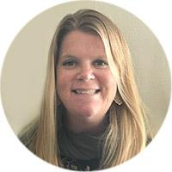
Today’s Facilitators
Colleen Reinert
Program Director
MHP Salud
Darlene Jenkins
Senior Director of Programs
National Health Care for the Homeless Council
Notes:
Individual introductions

Slide 3
Today’s Agenda
Welcome and Introductions
Chat Icebreaker
BPHC Update: Suma Nair, PhD, MS, RD
Q&A with Suma
Breakout Rooms
General Discussion
Conclusion
Topic: Peer Sharing/Roundtables
Notes:
Colleen

Slide 4
National Training and Technical Assistance Partners (NTTAPs)
Notes:
Colleen

Slide 5
HRSA COVID-19 FAQs
https://bphc.hrsa.gov/emergency-response/coronavirus-frequently-asked-questions?field_faq_category_tid=306&combine=
Notes:
Colleen

Slide 6
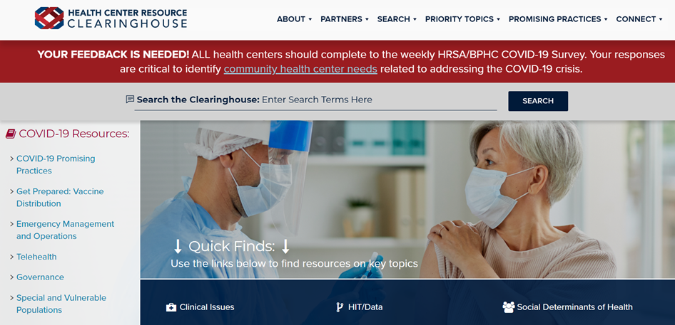
Health Center Resource Clearinghouse
www.healthcenterinfo.org
Notes:
Colleen

Slide 7
Got Vaccinators?
Some health centers are facing challenges recruiting qualified individuals to support and expand their vaccination capacity.
If you have promising practices, sample recruitment tools or template documents, please consider sharing on the Health Center Resource Clearinghouse Vaccine Distribution page by completing this short submit your resource form.
Notes:
Colleen

Slide 8
Zoom Etiquette
All participants muted upon entry
Cameras on (if possible)
Engage in breakout rooms
Raise hand if you would like to unmute
Notes:
Colleen

Slide 9
Next Roundtable: Friday, May 21st
May 21st, will be the final Roundtable of this series
Health Center Promising Practices and NTTAPs COVID-19 Resources
This will be in addition to our regular agenda which includes BPHC updates
Notes:
Colleen

Slide 10
Chat Icebreaker:
Name and role
Health center name
Health center location and no. of sites
Notes:
Darlene

Slide 11
Poll #1
Did you attend the roundtable on 4/23?
Yes
No
Notes:
Darlene

Slide 12
Poll #2
With which of the following local HUD grantees and program participants does your health center have existing or expanded partnerships to fight COVID-19?
Single- and multi-family housing owners/managers
Public housing authorities
Continuums of Care and homeless providers
Other (provide details in chat)
None
N/A
Notes:
Darlene

Slide 13
Poll #3
Which of the following strategies has your health center used to combat COVID-19? (choose all that apply)
Targeted outreach for testing and vaccines
Providing information to promote vaccine confidence
Offering testing and vaccinations
Facilitating vaccine clinics at other sites (like public housing buildings/farms/etc.)
Providing information about primary care services to community members
Assisting with transportation for testing and vaccination
Other (provide details in chat)
None
N/A
Notes:
Darlene

Slide 14
BPHC Update
Suma Nair, PhD, MS, RD Director, Office of Quality Improvement Bureau of Primary Health Care Health Resources and Services Administration
Notes:
Darlene to segway to BPHC speaker- Darlene ask if participants have any questions can chat in box or….raise hand and unmute

Slide 15
Health Center COVID-19 Vaccine Program Special Populations Roundtable May 7, 2021
Suma Nair PhD, MS, RD
Director, Office of Quality Improvement
Bureau of Primary Health Care (BPHC)
Health Resources and Services Administration (HRSA)

Slide 16
Health Center COVID-19 Vaccine Program Overview
HRSA and CDC partnership to directly allocate supply of COVID-19 vaccine to health centers
All HRSA-funded health centers and Health Center Program look-alikes are now eligible
List of participating health centers: https://www.hrsa.gov/coronavirus/health-center-program/participants
“…equity is our North Star here.”
- Dr. Marcella Nunez-Smith, Chair of the COVID-19 Health Equity Task Force

Slide 17
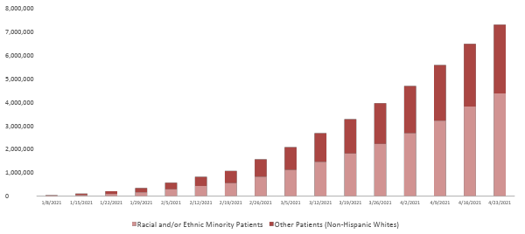
Overall COVID-19 Vaccines Administered to Date by Health Centers: Race/Ethnicity Known
A total of 8,718,916 COVID-19 vaccine doses
have been administered by health centers to date.
For additional information regarding Health Center COVID-19 Vaccinations Among Racial and Ethnic Minority Patients, please visit: https://data.hrsa.gov/topics/health-centers/covid-vaccination

Slide 18
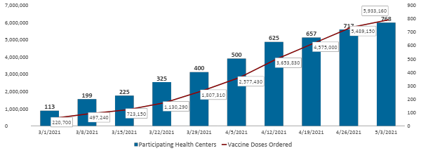
Health Center COVID-19 Vaccine Program
To date, health centers have ordered 5,933,160 doses for 2,096 sites.

Slide 19
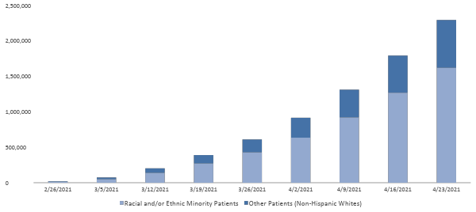
COVID-19 Vaccines Administered to Date by Health Centers: Race/Ethnicity Known
Health Center
COVID-19 Vaccine Program
Through the Health Center COVID-19 Vaccine Program, a total of 2,642,218 COVID-19 vaccine doses have been administered by participating health centers to date.

Slide 20
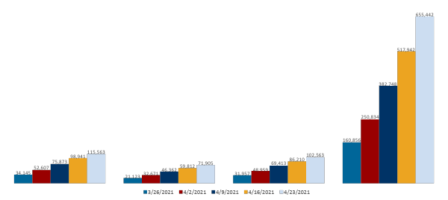
COVID-19 Vaccines Administered to Date by Health Centers: Special Populations Receiving Doses
Health Center
COVID-19 Vaccine Program
Through the Health Center COVID-19 Vaccine Program,
a total of 2,642,218 COVID-19 vaccine doses have been administered
by participating health centers to date.
Patients with Limited English Proficiency:
25% (655,442) of doses
Migratory & Seasonal Agricultural
Workers:
4% (115,563) of doses
Patients Experiencing Homelessness:
3% (71,905) of doses
Patients Who Are Residents of Public Housing:
4% (102,563) of doses

Slide 21
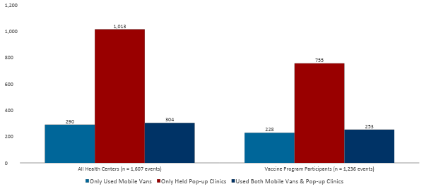
Community-Based Vaccination Efforts: Week Ending 4/23/2021
40% of all health centers and 48% of vaccine program participants used mobile vans or held pop up clinics to administer vaccines via a combined total of 1,607 community-based events last week*
*Of those who responded to the voluntary, weekly Health Center COVID-19 Survey (433/1,085) and Survey Addendum (289/607) for 4/23/21

Slide 22
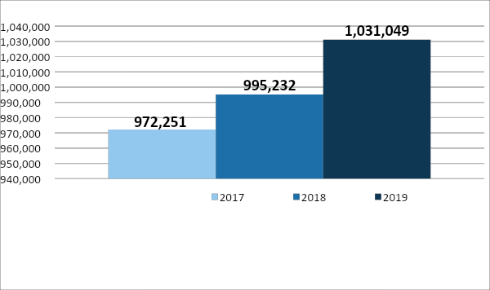
Migrant Health Center Program Highlights
Migrant and Seasonal Agricultural Workers
In 2019, the Health Center Program served more than 1 million agricultural workers.
176 health centers receive section 330g funding, receiving more than $412 million in funding in 2019.
3.46% of all health center patients are agricultural workers.
Source: HRSA 2019 Uniform Data System

Slide 23
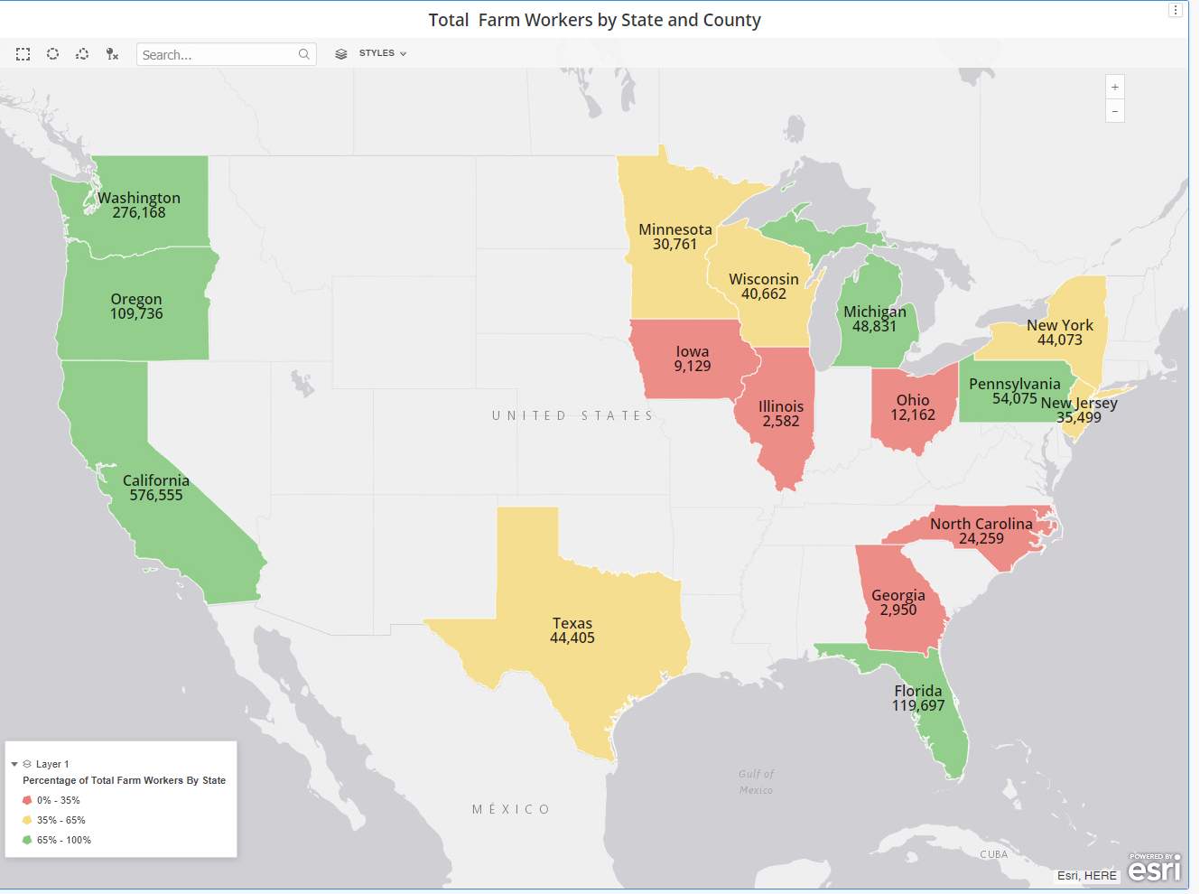
States and Counties with High Concentration of MSAW
Migrant and Seasonal Agricultural Workers
Top 5 States
California
Washington
Florida
Oregon
Pennsylvania
Source: 2017 Census of Agriculture (U.S Department of Agriculture-National Agricultural Statistics Service)

Slide 24
Supporting COVID-19 Vaccines for Migratory and Seasonal Workers in the Food and Agriculture Sectors
Migrant and Seasonal Agricultural Workers
All health centers should examine opportunities to vaccinate food/agricultural workers through in reach, outreach and by forming partnerships with growers/employers
Health centers in the 150 counties with the largest number of food/agricultural workers will be critical partners to ensure we are equitably vaccinating this population.
We will monitor progress through the weekly survey data on agricultural workers vaccinations and regularly share progress updates with our FDA/CDC colleagues.
Leverage our national training/technical assistance partners who are focused on migrant/seasonal farmworker health to identify and share best practices, as well as develop additional TA resources. This includes amplifying relevant COVID-19 resources from CDC and HHS.

Slide 25
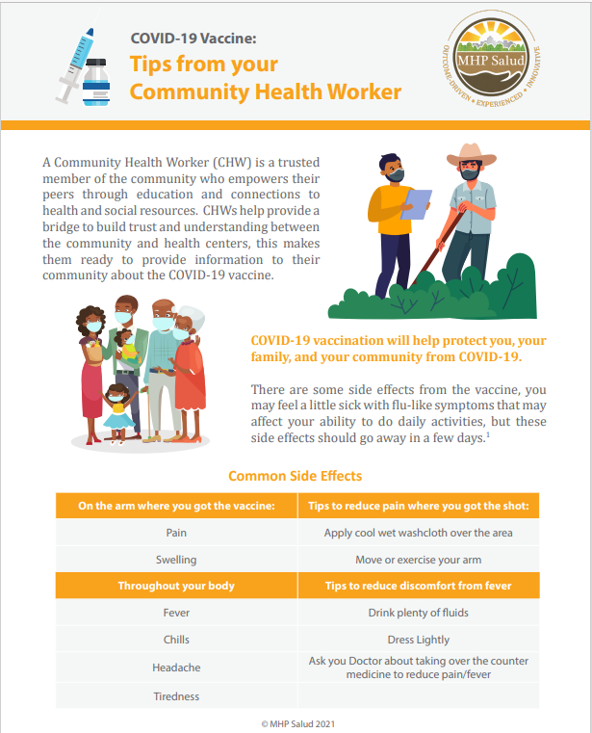
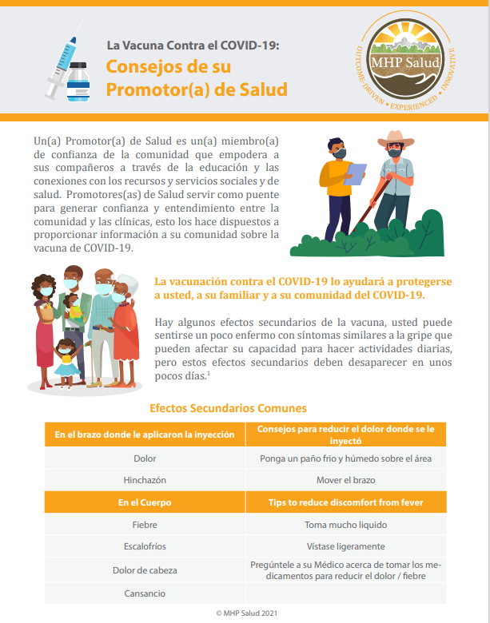
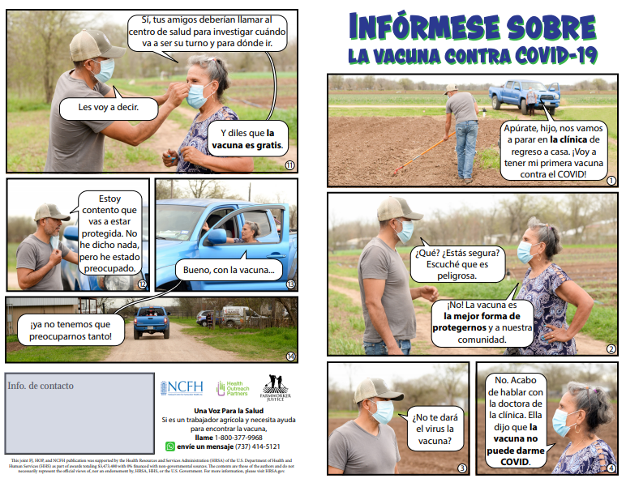
Resources for Engagement
The National Center for Farmworker Health offers literacy-sensitive resources in print, video, audio and radio files, social media content, and images. They are available in Spanish, Haitian Creole, and indigenous languages such as Triqui, Mam, and Mixteco.
MHP Salud developed resources to help health centers build vaccine confidence for the MSAW population such as multi-lingual tip sheets for community health workers.
Farmworker Justice, Health Outreach Partners, and National Center for Farmworker Health developed a fotonovela to develop vaccine acceptance responding to questions we have heard from stakeholders working with agricultural workers.
CDC's COVID-19 Communication Toolkits for Migrants, Refugees and Other Limited-English-Proficient Populations has materials in more than a dozen languages.

Slide 26
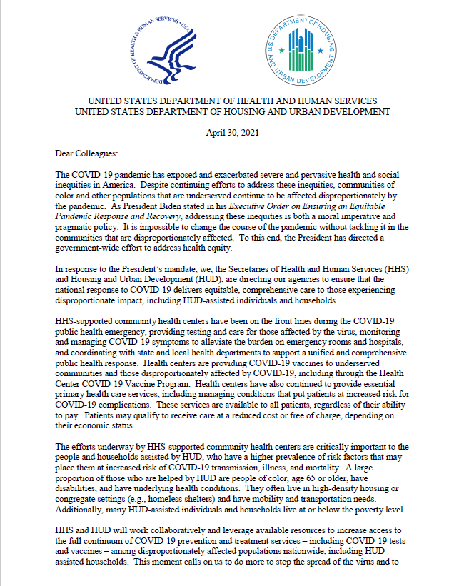
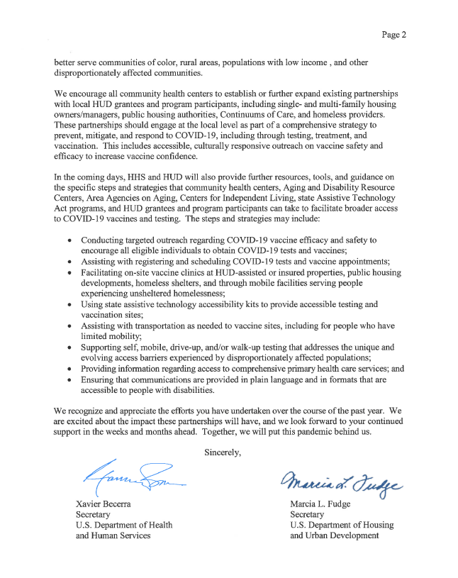
Supporting People Experiencing Homelessness/HUD-Assisted Individuals and Households
Conduct targeted outreach on COVID-19 vaccine efficacy and safety to encourage all eligible individuals to obtain COVID-19 tests and vaccines
Assist with registering and scheduling COVID-19 tests and vaccine appointments
Facilitate on-site vaccine clinics at HUD-assisted or insured properties, public housing developments, homeless shelters, and through mobile facilities serving people experiencing unsheltered homelessness
Use state assistive technology accessibility kits to provide accessible testing and vaccination sites
Assist with transportation as needed to vaccine sites, including for people who have limited mobility
Support self, mobile, drive-up, and/or walk-up testing that addresses the unique and evolving access barriers experienced by disproportionately affected populations
Provide information regarding access to comprehensive primary health care services.
Ensure communications are in plain language and accessible formats for people with disabilities.

Slide 27
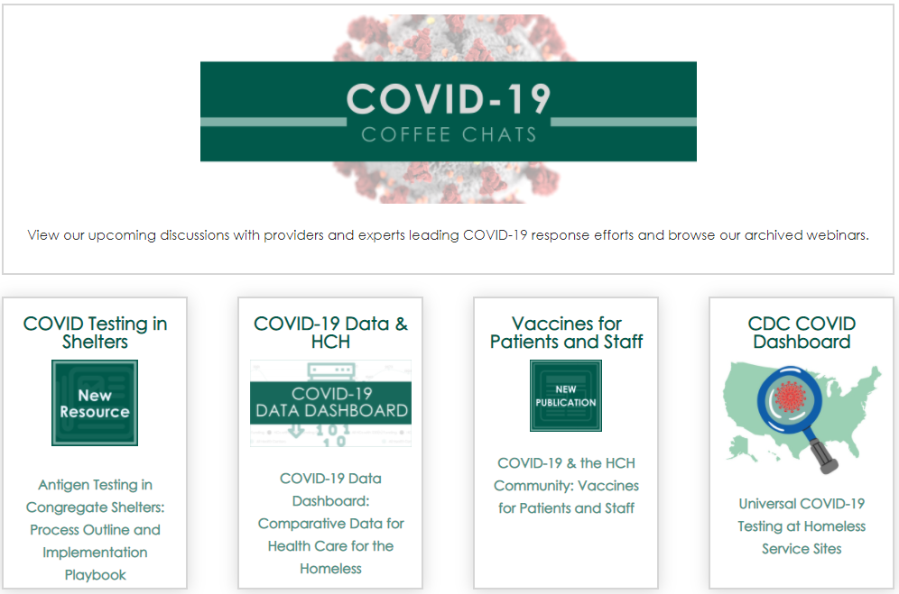
Resources for Engagement
National Nurse-Led Care Consortium hosted a webinar session to explore innovative partnerships that engage students to support COVID-19 education, outreach, and vaccine efforts.
National Health Care for the Homeless Council developed resource guide on providing key strategy, planning and operational considerations for implementing COVID-19 screening testing in congregate shelters; a data dashboard provides COVID-19 testing and vaccination event data hosted by shelter or encampment-based service sites; and is hosting a webinar series to highlight successful partnerships between HCH facilities and local governments around the United States.
National Center for Health in Public Housing developed a COVID-19 data dashboard using HRSA’s Health Center COVID-19 Survey data.

Slide 28
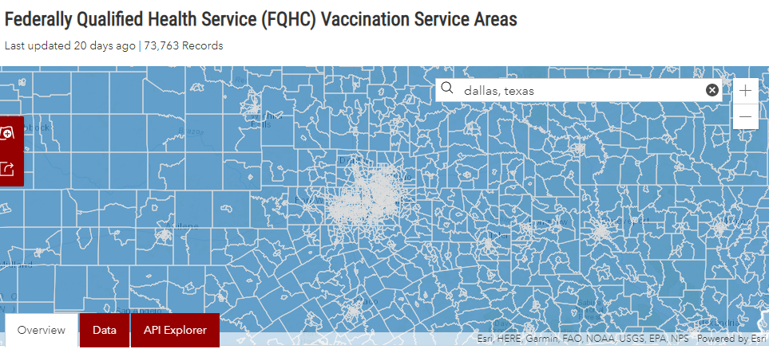
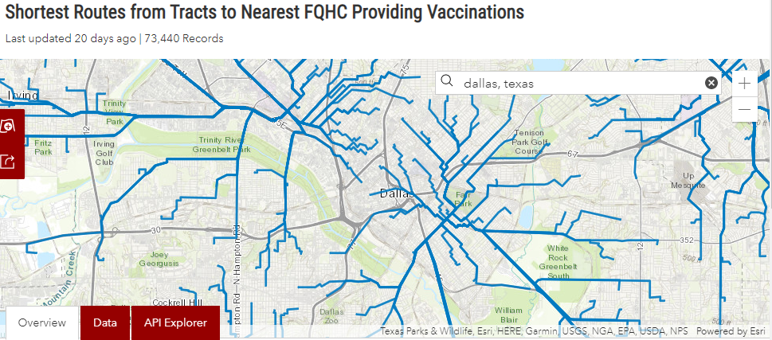
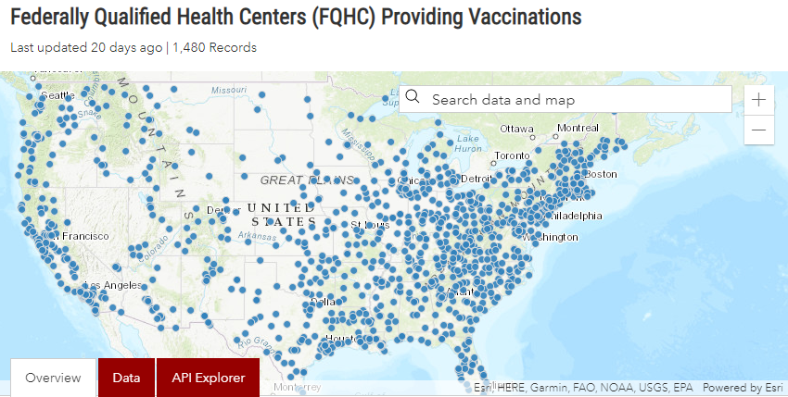
HUD Resources
Mapping Tools and Resources
Federally Qualified Health Centers Providing Vaccinations
Federally Qualified Health Service (FQHC) Vaccination Service Areas
Shortest Routes from Tracts to Nearest FQHC Providing Vaccinations

Slide 29
Health Center Resource Clearinghouse COVID-19 Vaccine Distribution Landing Page
Go to https://www.healthcenterinfo.org/priority-topics/covid-19/covid-19-vaccine-distribution/

Slide 30
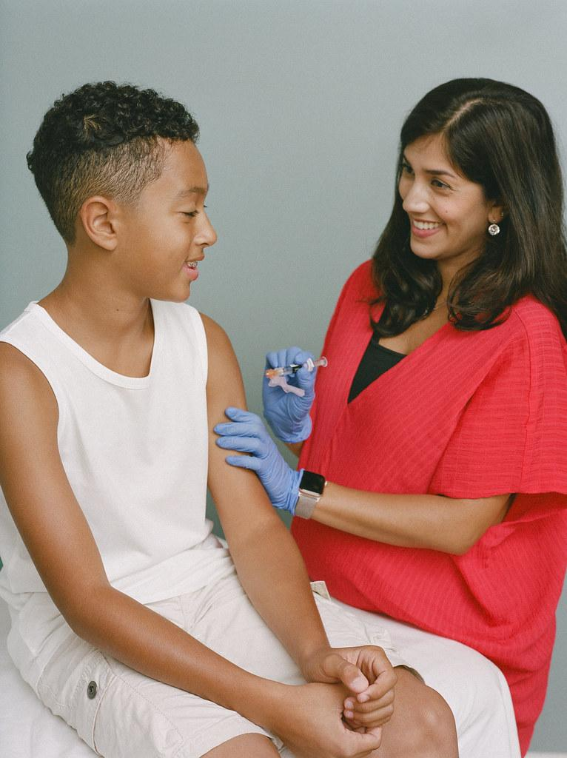
Coming Soon: Vaccinating Adolescents
Adolescents (12-17)
Awaiting EUA for Pfizer vaccine in 12-15 year olds (16-18 already authorized)
Health Center COVID-19 Vaccine Program aims to vaccinate 1 million adolescents (approx. 1/3 of adolescents served in HC program) by September
Pfizer deconsolidation pilot in process
Key partners: PCAs, state IZ programs, School Based Health Alliance
SELF Magazine/Creative Commons

Slide 31
Primary Care Association (PCA) Environmental Scan Request
Adolescents (12-17)
PCA immediate assistance requested
Email sent Thursday May 6, 2021; Response spreadsheet requested by May 14, 2021
Environmental scan assessing health center readiness to vaccinate adolescents and technical assistance needs
Encourage review of all health centers but focus on maximizing capacity of:
Health centers with school-based health sites
Health centers in the state that serve high volume of adolescents
Information is critical for developing a targeted and effective strategy to vaccinate 1 million adolescents through the Vaccine Program by September

Slide 32
Questions?

Slide 33
Resources
TA Topic | Contact Information
BPHC Contact Form | https://bphccommunications.secure.force.com/ContactBPHC/BPHC_Contact_Form Select fourth category: “Health Center COVID-19 Vaccine Program”
Program Webpage | https://www.hrsa.gov/coronavirus/health-center-program
Program FAQs | https://bphc.hrsa.gov/emergency-response/coronavirus-frequently-asked-questions
Survey Questions | https://bphc.hrsa.gov/emergency-response/covid-19-survey-tools-questions
Primary Care Associations | https://bphc.hrsa.gov/qualityimprovement/strategicpartnerships/ncapca/associations.html
Immunization Program Managers | https://www.immunizationmanagers.org/page/MemPage

Slide 34
Thank You!
Bureau of Primary Health Care (BPHC)
Health Resources and Services Administration (HRSA)
For general information on the Health Center COVID-19 Vaccine Program, please visit: https://www.hrsa.gov/coronavirus/health-center-program.
bphc.hrsa.gov
Sign up for the Primary Health Care Digest

Slide 35
Breakout Rooms
Each Breakout Room will have 2 NTTAP staff for each room- a Facilitator and a Notetaker
Breakout Rooms randomly assigned
20 minutes in Breakout Rooms
One Health Center volunteer to share during the general report out
Each group to share one take-away
Notes:
Darlene

Slide 36
Breakout Room Questions for Discussion
What’s one thing you would like to share with BPHC about your experience participating in the vaccine program?
What additional questions do you have for BPHC?
What do you need from BPHC related to the Vaccine Program?
What was the most important lesson learned from implementing a vaccine program in your health center?
Who were/are your most valuable community partners in outreach or distribution?
How did you approach building vaccine confidence in your special and vulnerable populations? Are there populations you are still concerned about adequately reaching?
How is your health center addressing concerns of staff burnout? How are you promoting resiliency going forward? How are you recruiting/obtaining additional staffing?
Notes:
NTTAPS

Slide 37
General Discussion/Report Out
One Health Center volunteer to report out from Breakout Rooms
Share at least one major takeaway
Notes:
Colleen

Slide 38
Resources
NACHC Weekly COVID-19 Survey Infographic
Infographics: National Findings on Health Centers' Response to COVID-19
NCHPH Public Housing Primary Care Dashboard http://nchph.org/DASHBOARD/
NCFH COVID-19 web page
COVID-19 - NATIONAL CENTER FOR FARMWORKER HEALTH (ncfh.org)
Translated Materials Library (NRC-RIM)
https://nrcrim.umn.edu/health-education/translated-materials-library
Farmworker Justice COVID-19 page
http://www.farmworkerjustice.org/advocacy_program/covid-19/
Notes:
Colleen

Slide 39
Resources (cont.)
COVID-19 Homeless System Response: Vaccine Planning and Distribution- HUD: https://www.hudexchange.info/resource/6229/covid19-homeless-system-response-vaccine-planning-and-distribution/
COVID-19 Resources for Health Centers Serving People Experiencing Homelessness https://nhchc.org/clinical-practice/diseases-and-conditions/influenza/
Council C-19 Flash Blast https://nhchc.org/council-covid-19-flash-blast/
Infographic on the Vaccine https://nhchc.org/wp-content/uploads/2021/02/COVID-19-Infographic-3.pdf
Letter to Governors and Local Officials: Increasing COVID-19 Vaccine Access for People Experiencing Homelessness
COVID-19 Resources for Asian American-, Native Hawaiian-, and Pacific Islander-Serving Community Health Centers: http://coronavirus.aapcho.org/
Notes:
Colleen

Slide 40
Last Roundtable:
Friday, May 21, 2021
Notes:
Colleen

